Slide 1
Rule-based, thesaurus-based or based on machine learning – different approaches to semantic content enrichment
NLP Workshop, Institute of Bulgarian Language,
Sofia, March 5 2014
Stefan Geißler
TEMIS Deutschland GmbH
www.temis.com

Slide 2
Introducing TEMIS
Software and Services around Text Analytics, „Text Mining“, created 2000
Headquarter Paris/France, Offices in Heidelberg/Gemany, New York/USA, Montreal/Canada, London/UK
~70 people
Flagship product: Luxid®
Acquisitions
NLP team + technology from Xerox in Grenoble 2002
I3 Analytics team + technology in 2013 in Columbia/USA

Slide 3
Key references

Slide 4
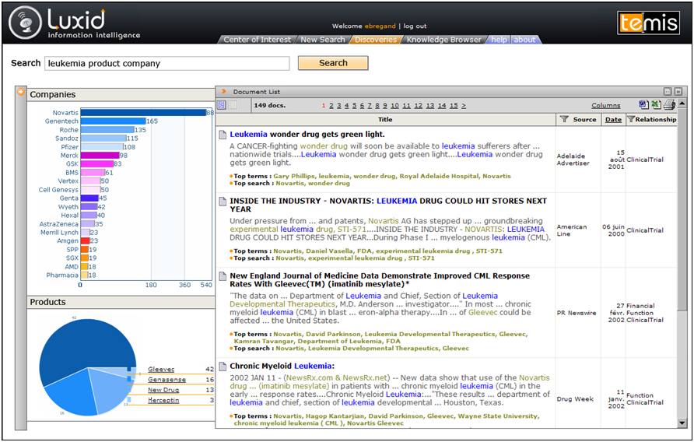
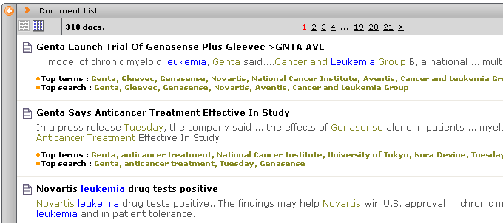
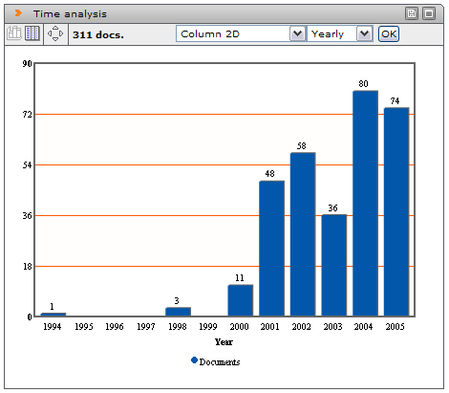
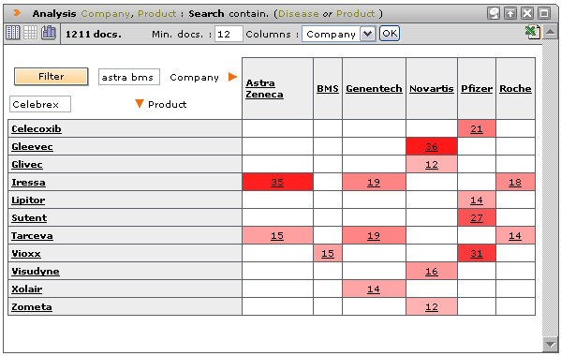
„Semantic Enrichment“: What for?
Simple string search: Is that sufficient?
Searching on enriched content: The documents now „know“ that Novartis is a company and Gleevec is a drug
This allows for new kinds of analysis and quicker insights

Slide 5
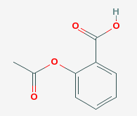
Semantic Enrichment
Aspirin (Drug, Bayer)
CC(=O)OC1=CC=CC=C1C(=O)O
MW=180.157 g/mol
Link to PubChem
Link to PDB
Link to DrugBank
+
+
+
Content Hyper-linking
+
Annotated, enriched and linked document
Text Mining Service
Linking Repository
+
+
Content Enrichment
Aspirin (Drug, Bayer)
CC(=O)OC1=CC=CC=C1C(=O)O
MW=180.157 g/mol
…
+
Enriched and annotated document
Text Mining Service
Inhouse data
Content Annotation
Aspirin (Drug, Bayer)
Annotated document
Text Mining Service
Public data
Raw document
… Aspirin….

Slide 6
“Skill Cartridges™”
Analysis components: What needs to be indexed?
Person names? Places? Companies? Diseases? Mergers&Acquisitions? Criticism or Approval? Company-specific terminologies? …
Skill Cartridges™ are
Combinations of lexical knowledge (thesauri, …) and rules
Skill Cartridges™ are
TEMIS Products: generic, directly usable
… or project-specific: Built on specific request
Built?
By TEMIS
… or by Partners and clients using dedicated development environment tools (Luxid Studio)
Notes:
6
Admin tool for editors SENTIMENT TONE
INTEROPERABILITY – within the DNA architecture natural fit

Slide 7
Enrich with what?
Different scenarios and diffferent client demands require different approaches
A „one-fits-all“ approach is not suitable
Necessity to select from a broad range of
Sample examples
Corpus with documents on „radioactivity“ (ca 5000 documents from Medline)
Successive enrichment with different approaches
Tokenisation: Document → Words
Part-of-Speech-Tagging: Words → Grammatical Categories
„Chunking“: Identification of syntactic phrases
Relevant Phrases: Ranking of results according to assumed „relevance“
Thesaurus-based Indexing: More than searching for strings!
Relations: How do Entities in the text relate to one another?

Slide 8
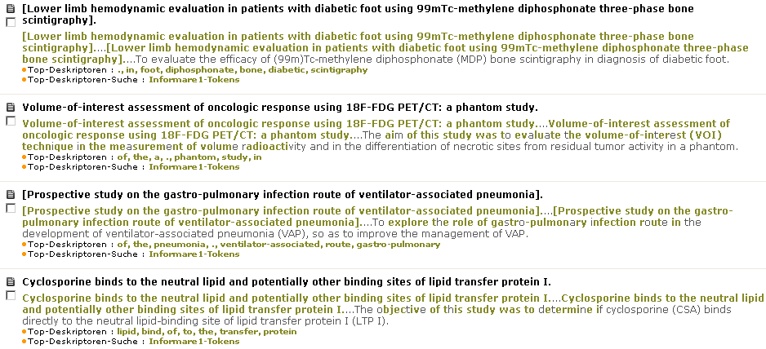
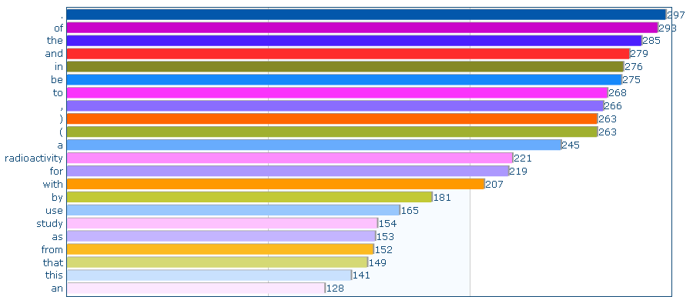
Tokenisation/Lemmatisation
Observation: the most frequent words are not too informative. (Function words, …).

Slide 9
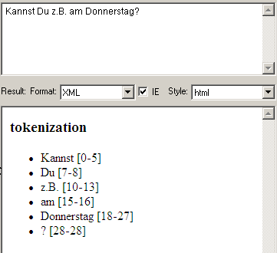
Tokenisation
Sample analysis:
„z.B.“ as one token (no splitting at „.“)
Message:
Seemingly simple tasks at the beginning of the chain are important for subsequent steps.
Challenge: Clean Processing on different document types, laguages, …
100%accuracy is not possible!

Slide 10
Observation
Tokens alone won‘t be enough
Required is a determination of the grammatical category
The Process of assigning the grammatical category is called „Part-of-Speech Tagging“
Instead of filtering „the“, „of“, „and“, … via a stop word list the text is analysed and enriched with POS tags
Now possible:
„Show me the nouns in the text corpus“

Slide 11
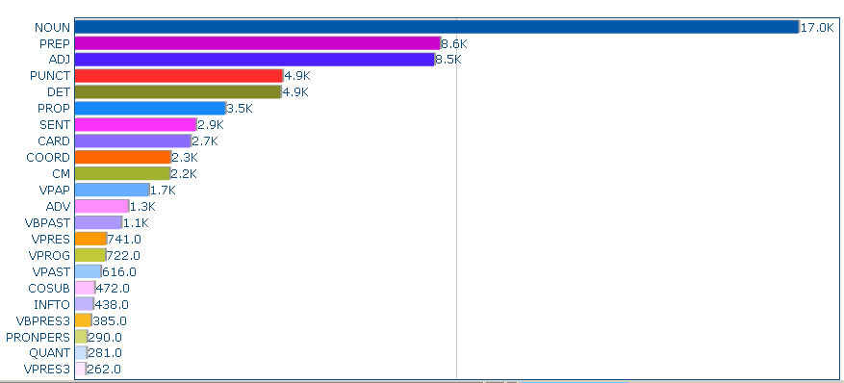
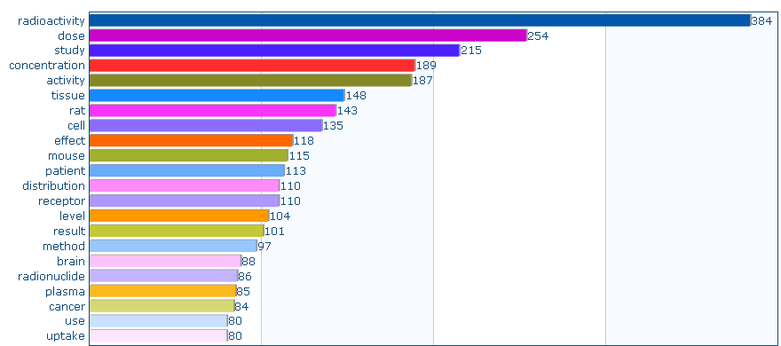
„Part-of-speech Tagging“
Focussing on meaningful words ( e.g. nouns)
Not via a stodword list but via linguistic processing
The topic of the corpus is clearly visible.
Words are mapped to their uninflected lemma

Slide 12
Observation
In english single tokens are often only parts of larger meaningful units (noun phrases, NPs)
English: „printer device driver library file size“
Deutsch: „Donaudampfschifffahrtskapitänsmütze“
Failing to recognize the larger noun phrases leads to a loss of information
Required is a process that builds upon the POS tags and recognises NPs
Rules e.g..: NP -> Det? Adj* Noun+
„printer“, „modern printers“, „the heavy old printer“, „the heavy old laser printer“

Slide 13
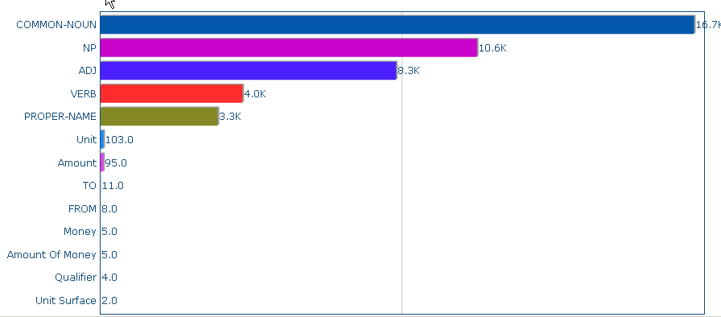
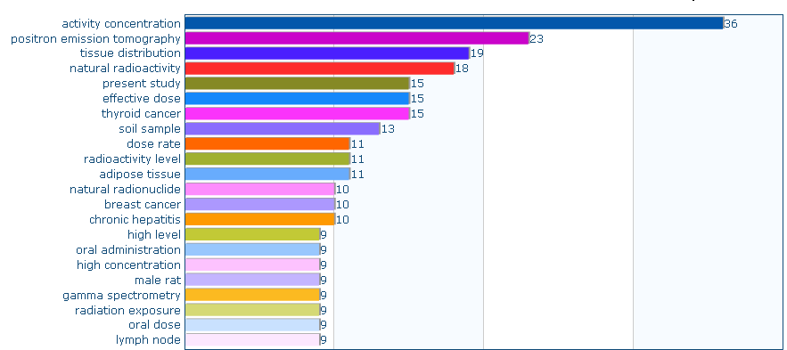
„Chunking“: Identification of NPs

Slide 14
Observation
Not all NPs convey the same level of information
Some are highly relevant: „minimum detectable concentration“, …
Some less so: „a method“, „the sample“, „two cases“, …
Required: A method, to make sort NPs appropriately
Assign a confidence score to all NPs
The n best NPs according to this criterion represent the topic of the document (like a list of hand-picked keywords)
Criteria: Position in the test, Frequency, Syntactic form? Frequency in the general language? …
Requirement: Method must be fast and stable and not require explicit domain knowledge

Slide 15
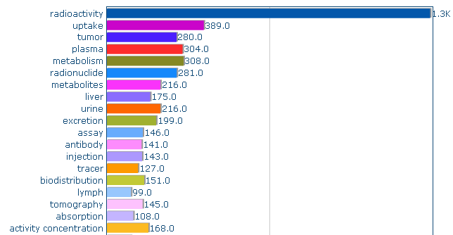
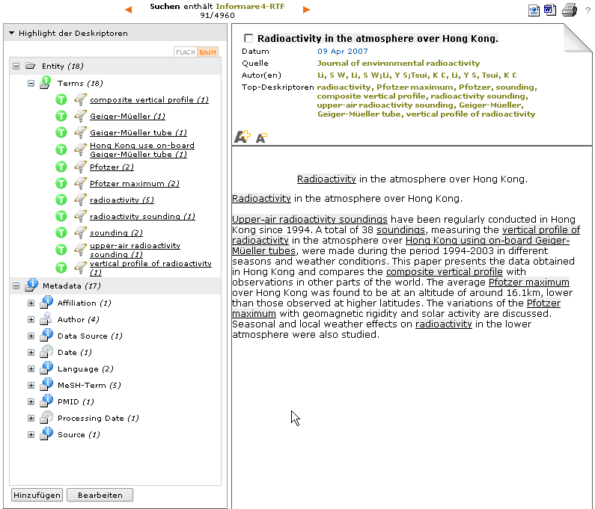
Meaningful NPs established on a document corpus.
Selection is more specific than a purely frequency sorted list.
List of suggested terms for one document

Slide 16
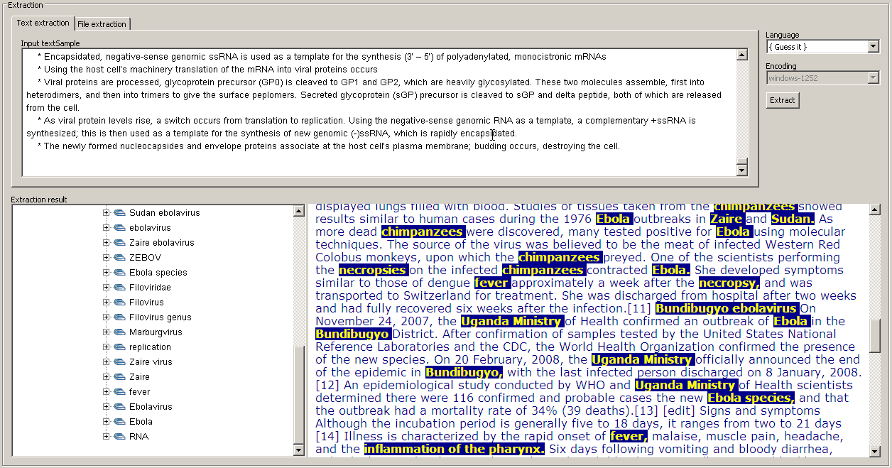

Slide 17
Observation
Approach yields meaningful expressions …
… but these phrases are„untyped“
Which ones refer to a disease, a device, a body part, …
Required: Employing a domain specific thesaurus
E.g. for medical topics the „MeSH“ (Medical Subject Headings) is a frequently used thesaurus
… and construction of a annotator (TEMIS „SkillCartridge“®) in order to make the entities and their hierarchical information usable as „Facettes“

Slide 18
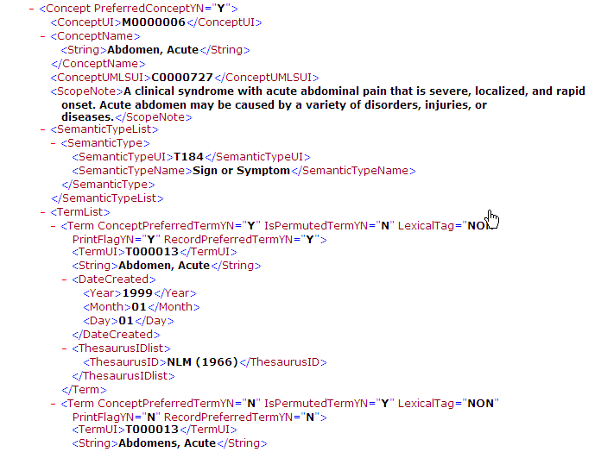
MeSH – some numbers
2011 version ~50000 concepts
XML file ~ 300MB
850.000 terms

Slide 19
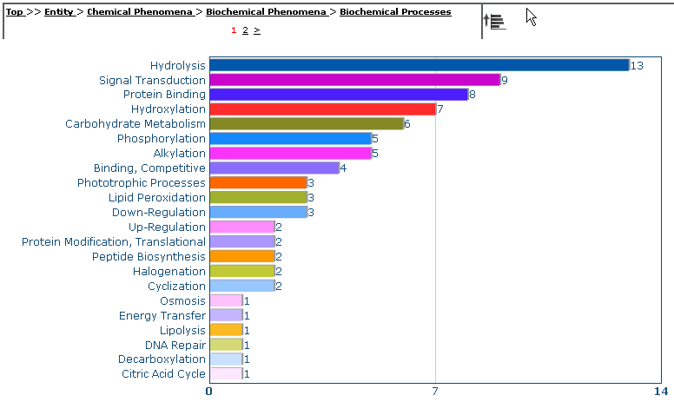
Indexing with hierarchical Thesaurus

Slide 20
How to construct these annotators?
Introduction, overview, some terminology
Scenario 1
Vocabulary available in list format → Create a Skill Cartridge with the “Knowledge Editor”
Scenario 2
Vocabulary available as thesaurus → Create a Skill Cartridge with the Knowledge Editor and the “STF” Skill Cartridge Template
Scenario 3
Extraction of relations → Create a Skill Cartridge in the “Skill Cartridge Builder”
Scenario 4
Modelling a scenario with machine learning → Create a training corpus in the “Annotation Workbench”
Scenario 5
Benefitting from the Luxid Community: Skill Cartridges set up by third parties

Slide 21
Skill Cartridge® Creation Process
Source Reader
Luxid (Server)
Output Generator
Enriched
Output
SC
SC
SC
SC
1
2
3
4
Export
Quality Assessment
Luxid (Studio)
Luxid®
Annotation
Workbench
Luxid®
Luxid®
Luxid®
Annotation
Workbench
Category
Workbench
Knowledge
Editor
Skill
Cartridge®
Builder
Skill Cartridge® Development
Notes:
Standalone tools on IDE Studio server: KE, SCB, AWB.
Build SC with KE and SCB, test on AWB, back to KE and/or SCB for dev. (Export manual annotations from AWB to KE if necessary)
Export SC to production IDE:
SC(a):Semantic based
SC(c):Categorisation
SC(t):Taxonomy based
SC(St):Statistical
Launch workflow.
Use Dynamic Mapping for minor changes.
Back to KE vie Dynamic Mapping importation to modify original SC.

Slide 22
Definitions
Lexicon
List of words or expressions, potentially organized hierarchically (then called taxonomies or thesauri)
Knowledge
Knowledge Editor view where lexicons and thesauri are added, created, modified
Entity
Result of the annotation of an entry of the lexicon in the text
Attribute
Information carried with the entity in the output
Strategy
The way lexicon is introduced into a SC
Entry point
Specific entry in an existing SC allowing lexicon integration
Synchronization
The process of updating a SC with the changes that were made in the knowledge

Slide 23
Different flavors of „Skill Cartridges“
Scenario 1: Import a simple list of terms
Scenario 2: Import a structured thesaurus
Scenario 3: Adding hand-crafted rules
Scenario 4: Machine Learning

Slide 24
Workshop Agenda
Scenario 1
Vocabulary available in list format → Create a Skill Cartridge with the “Knowledge Editor”
Example: Create a Skill Cartridge of the list of german Bundesliga Soccer teams

Slide 25
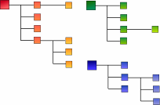
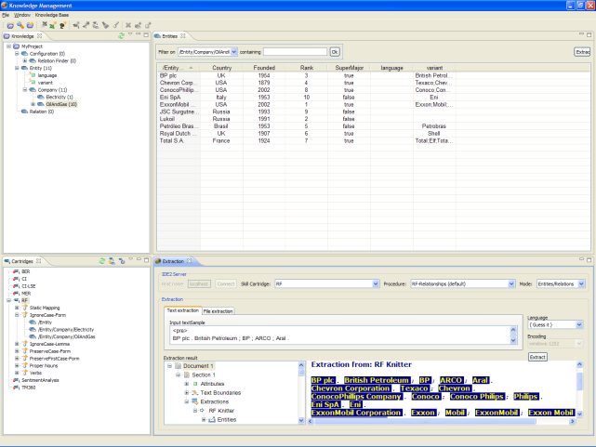
Knowledge Editor Architecture
Studio IDE
retrieve
attributes
SC
SC
Database
synchronize
modify
…
…
store
import
Lexicon
Type hierarchy
Thesaurus

Slide 26
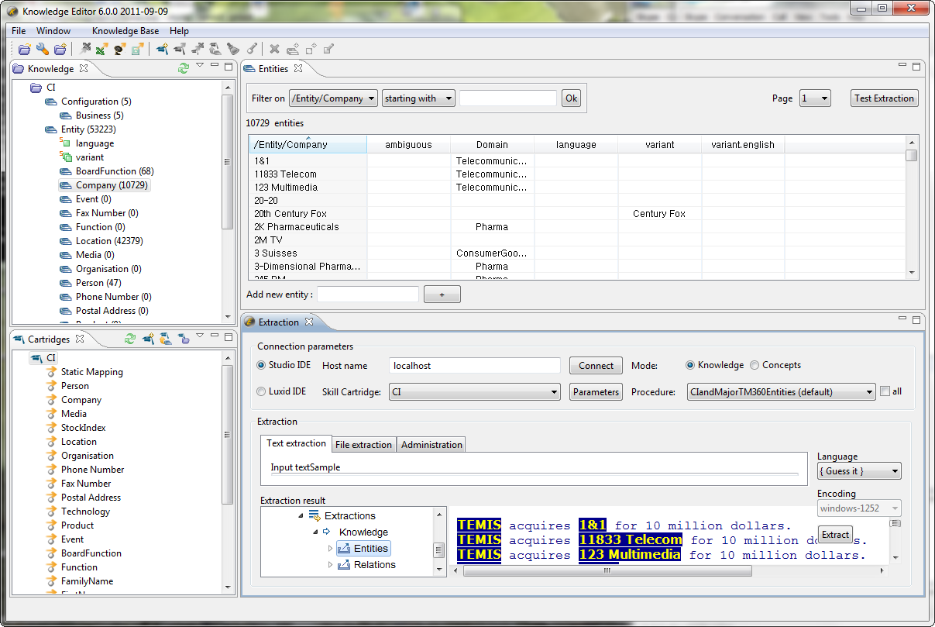
Knowledge Editor Overview
Knowledge Base
Management
Lexicon definition
Skill Cartridges installed on IDE Studio
Output check

Slide 27
Luxid® Knowledge Editor Step by Step
Open a project (create one if required)
Assign a Skill Cartridge® to the project (install it if required)
Create knowledge:
Import/modify lexicon or thesaurus
Create new types, attributes, …
Assign knowledge types to each entry point (i.e. choosing the appropriate strategy)
Synchronize the Skill Cartridge®
Test extraction and check annotation results
Adjust and resynchronize if necessary
Generate a new .SCA file for production

Slide 28
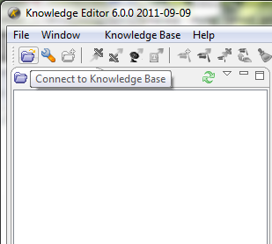
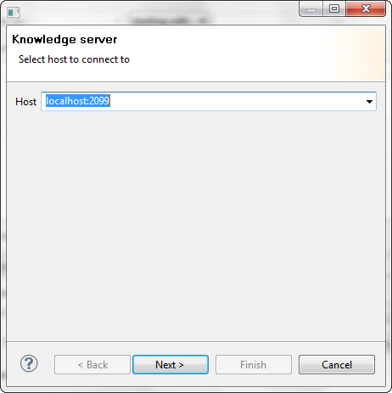
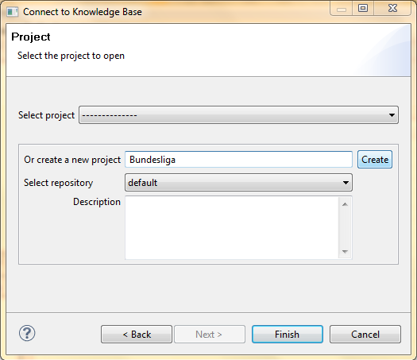
Opening/Creating a project
1- Connect to the Knowledge Base
2- Select the repository if necessary
3- Select an existing project or create one
4- Finish
The Knowledge, Entities and Cartridges views display components of the new project or of the existing project.

Slide 29
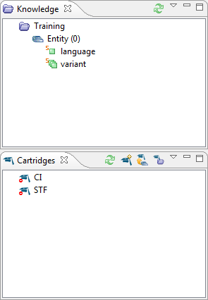
Knowledge and Cartridges
New project
An empty project is created
Entities have two default attributes
The list of the available Skill Cartridges installed on the IDE Server is displayed.
Notes:
Attributes :
Language (force extractions in the defined language)
Variants (synonyms, …).
(expression will be delt with later)
In the screenshot ckill cartridges are not assigned to the current project

Slide 30
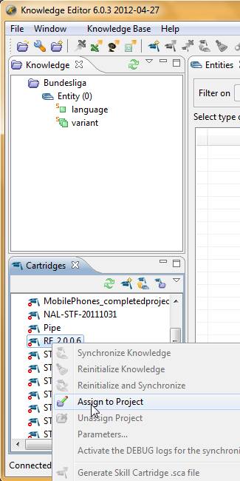
Assign a skill cartridge to a project
“RF” Skill Cartridge is a temolate, ready to receive list-based vocabularies
Assign it to the Bundesliga project
Accept the defaults („Yes To All“)
Notes:
It is possible to assign several skill cartridges to a same project): for instance CI and TM360 to manage common lexicon

Slide 31
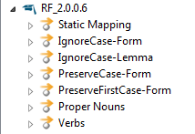
Assignment
The Skill Cartridge® Entry points appear in the Cartridges view
IgnoreCase-Form
For an entry « Shell », will recognize shell and Shell
IgnoreCase-Lemma
For an entry « Shell », will recognize shell, shells, Shell and Shells
PreserveCase-Form
For an entry « Shell », will recognize Shell
PreserveFirstCase-Form
For an entry « Shell », will recognize Shell, SHELL and SHell, SHEll, etc

Slide 32
Import lexicons
Import a CSV file containing your lexicon
The CSV columns should reflect the columns in the Entities view (case sensitive): /Entity/BoardFunction;language;variant Board Member;en;member of the board
Preferred Label
Language
Variants

Slide 33
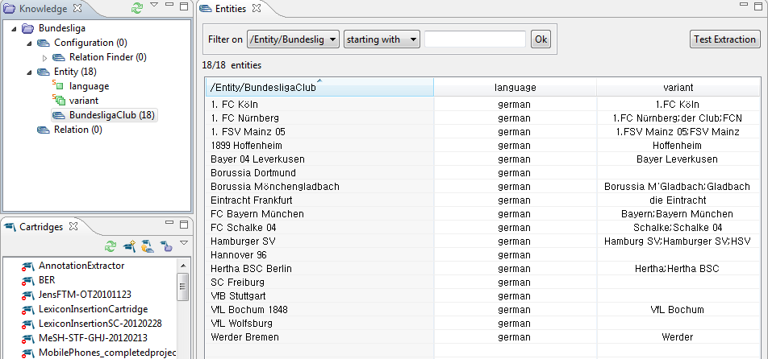
Adding entries
Select a type from the Knowledge view
In the Entities view, add some entities
The name entered in the first column will be the label of the annotation: its normalized form
Variants are other forms triggering the extraction of the same entity

Slide 34
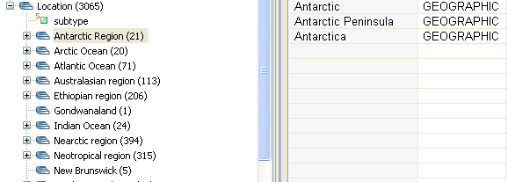
Multiple types import
/Entity/Location subtype
=/Antarctic Region/Antarctic GEOGRAPHIC
=/Antarctic Region/Antarctic Peninsula GEOGRAPHIC /Entity/Location/Antartic Region/ …
=/Antarctic Region/Antarctica GEOGRAPHIC
=/Arctic Ocean/Arctic Ocean GEOGRAPHIC
=/Arctic Ocean/Arctic Ocean/Alaskan Canadian Zone GEOGRAPHIC
=/Arctic Ocean/Arctic Ocean/Barents Sea GEOGRAPHIC /Entity/Location/Arctic Ocean/ …
=/Arctic Ocean/Arctic Ocean/Beaufort Sea GEOGRAPHIC
=/Arctic Ocean/Arctic Ocean/Chukchi Sea GEOGRAPHIC

Slide 35
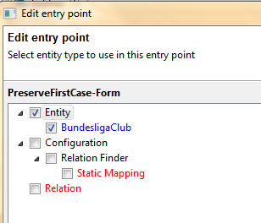
Assigning a type to an Entry Point
1- Right click on the appropriate entry point and choose Assign
2- Select the given type(s) of knowledge to be assigned to the selected entry point.
The knowledge hierarchy will be translated into entity hierarchies in the Cartridges view.

Slide 36
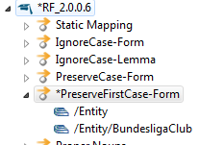
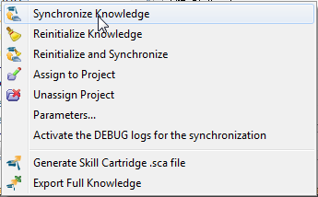
Synchronizing
When a * appears preceding the Skill Cartridge® name, it needs to be synchronized
Right click on the Skill Cartridge® name and select Synchronize Knowledge
The knowledge is injected into the SC according to the chosen strategy (sync is done when the * disappears)
The Skill Cartridge® is automatically updated on the IDE server to which the Knowledge Editor is connected.

Slide 37
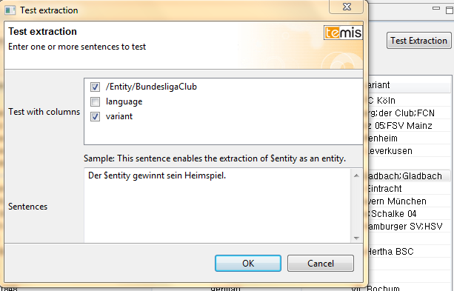
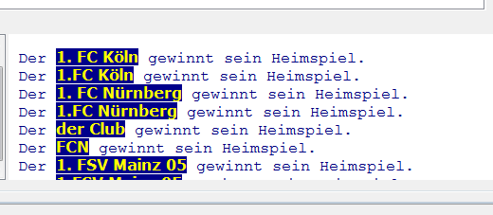
Testing Extraction
Run some tests

Slide 38
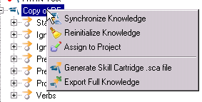
Generating .SCA file
If necessary, generate a Skill Cartridge® archive file
A .SCA file that can be installed on any IDE server is generated
NB: If using attributes, the Knowledge Base also needs to be exported

Slide 39
Attributes
Custom attributes are information that will be propagated with the entity in the output
Provided the Skill Cartridge® has the necessary configuration (in its .TSL file)
There are four types of attributes
String
Boolean (Yes/No)
Integer
Entity
Attributes can be added manually or via import

Slide 40
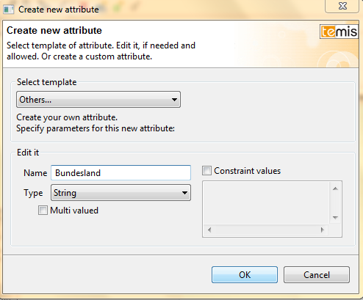
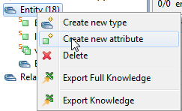
Attributes
To add an attribute manually, right click on an entity (leaves will inherit the attribute)
Configure the attribute to add
The attribute is added to the knowledge

Slide 41
Attributes
The new attribute is now part of the extraction result.

Slide 42
Using expressions
The expression column allows the use of simple Skill Cartridge® expressions for entity recognition
When using the “expression” column, the normalized form is NO LONGER used for the extraction (it is still the name of the entity)
The strategy used for this type DOES NOT apply to the expression
Can be used for
Variant factoring
Hillary Clinton, Hillary Rodham Clinton, Senator Clinton, Senator Hillary Clinton, Senator Hillary R. Clinton,…
can be written more in a more compact form :
(Sen|Senator)? / (Hillary|H)/ (Rodham|R)?/Clinton
Creation of exceptions to the type strategy
Acronyms for instance which need to be CasePreserve-Form, when company names will be CasePreserveFirst-form

Slide 43
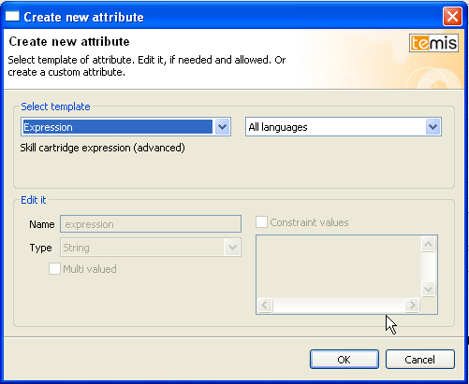
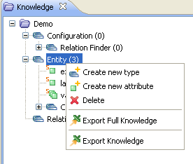
Using expressions
To create an expression, right-click on the chosen entity and choose Create new attribute
Choose Expression and confirm

Slide 44
Using expressions
Skill Cartridge® syntax for expressions
Within an expression, words are coordinated by “/”
Sanofi / Aventis
Several expressions are separated by “|”
Sanofi / Aventis | Aventis | Sanofi
Regular expressions can be used
? → 0 or one occurrence (term is optional)
* → 0 or more occurrences (ex: ASCO (20[0-9][0-9])* → ASCO, ASCO 2008 2009 2095)
+ → one or more occurrences (ex: ASCO (20[0-9][0-9])+ → ASCO 2008 2009 2095)
!A → any not empty string that is not A
Ranges can be used
[0-9] → any number from 0 to 9 (ex: ASCO 20[0-9][0-9] → ASCO 2000, ASCO 2010, etc)
[a-z] → any letter from a to z
[A-Z] → any letter from A to Z
[s,z] → s or z (ex: finali[s,z]ation → finalization or finalisation)

Slide 45
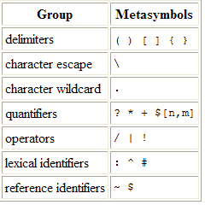
Using expressions
Skill Cartridge® syntax for expressions
Specific syntax for case and lemmatization
: → Search on form (ex: :IBM)
^ → Search on lemma (ex: ^pipeline)
\p → Case preserve (ex: \pIBM)
\C → Case preserve first (ex: \CIBM)
\i → Case insensitive (ex: \ipipeline)
# → Match on Xelda tag (ex: lead#NOUN)
Can be combined (order does matter)
\p:IBM
English Possessive
English possessive needs to be coded as a separate token
Ex: Boeing / ('s) / 737
Characters to be escaped
Means Preceded by a \p
Example: Inc\.

Slide 46
Workshop Agenda
Scenario 2
Vocabulary available as thesaurus → Create a Skill Cartridge with the Knowledge Editor and the “STF” Skill Cartridge Template
Direct import of thesaurus (if in certain format) into Knowledge Editor
Enhancing quality by specific processing:
Matching variations
Filtering / Sorting results

Slide 47
Thesaurus Management
Benefits
Use the Smart Taxonomy Facilitator (STF) skill cartridge to create a skill cartridge for any domain, based on existing taxonomies/thesauri with:
Native intelligent processing of entries to identify allowed variations
Relevance score computing according to position, frequency, length, node degree (neighboring thesaurus terms)
High customization capabilities, with a complete set of fine tuning options to adapt to specific environments.
Training procedure to learn on a representative corpus for enhanced performances
Supported thesaurus formats
SKOS (Simple Knowledge Organization System)
CSV (Comma Separated Value file format)
Additional parsers can be created using custom script parsers.

Slide 48
STF: Global procedure
Install STF and assign it to your project
Import a thesaurus
Assign the Thesaurus entry point to your knowledge
Train STF on a related corpus using procedures:
resetTraining
train: launch for each file from Extraction view
stopTraining
Synchronize STF with knowledge
Set STF parameters from the Extraction view
Test Extraction
Repeat the last 2 steps as many times as necessary
Notes:
Refer to STF User Guide for detailed info on parameters

Slide 49
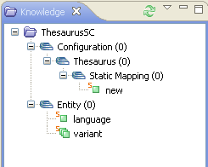
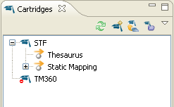
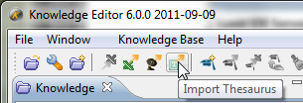
Importing Thesaurus (1)
Install STF
Assign it to the current project. Types and Entry points are displayed in the Knowledge and Cartridges views
Select « Import thesaurus » from the toolbar.

Slide 50
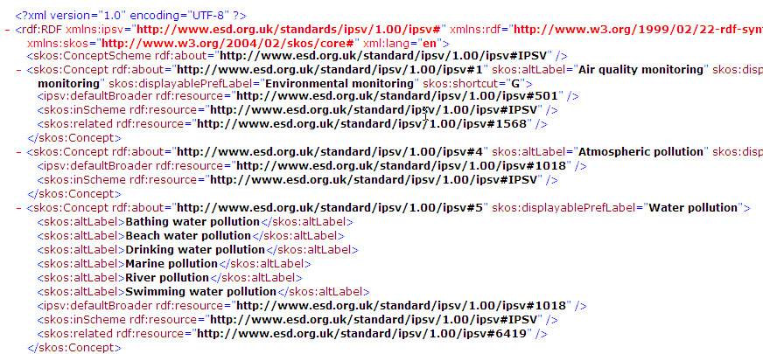
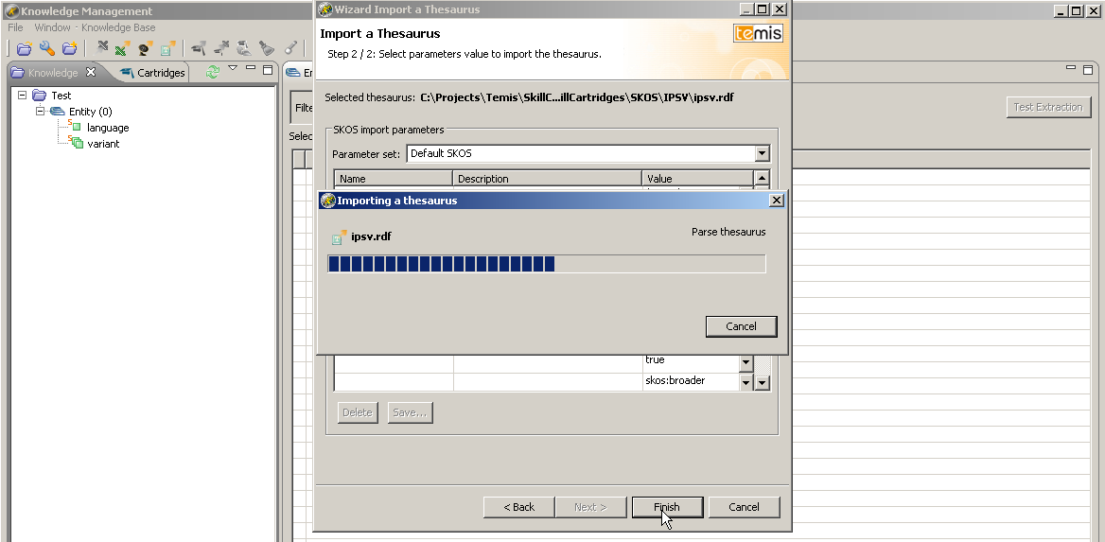
Direct import of existing thesauri
Knowledge editor capable to handle SKOS format
→ Direct access to many complex thesauri
Imported into Knowledge Editor
Example: IPSV (Integrated Public Sector Vocabulary) Thesaurus im SKOS- Format

Slide 51
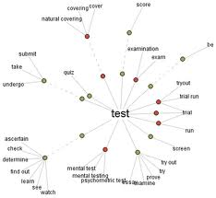
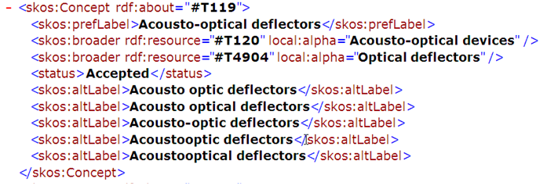
Thesaurus processing: Just matching strings?
Thesaurus never „complete“
Entities may be referred to with different expressions.
Just matching strings is not sufficient.
Allow systematic matching of variants of the imported terms
Goal: Increased Recall
Luxid
STF SC Builder
TEMIS Skill Cartridge
Preferred term identity
“Acousto-optical deflectors” score=1.0
Permutation approx. match
“Optic and acoustic deflector” score=0.8677
Insertion approx. match
“Acousto-optic base deflector” score=0.8339
Orthography approx. match
“Acousto-optical deflecter” score=0.9259
status
Normalized form of term
Thesaurus
Lexicons
Taxonomy
Broader terms
synonyms

Slide 52
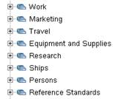
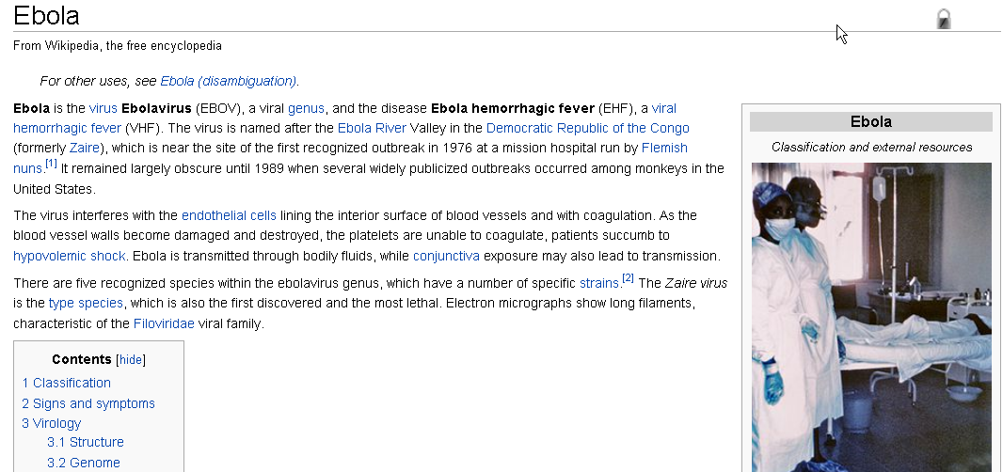
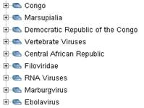
Thesaurus processing: Ranking
General observation: Not all the terms are equally „relevant“
Example: MeSH (medical thesaurus) : „Risk“, „Study“, „Human“, „Data“, „Adult“, …
Results need to be weighted: How relevant is the respective term in this document?
Goal: Increased „Precision“
Avoid returning irrelevant terms
Valid but uninteresting hits of the MeSH Thesaurus on a text on „Ebola“: „Marketing“ with confidence of 0.011: rather irrelevant here
Threshold
The relevant hits receive a more elevated score and can be identified by applying a threshold etc

Slide 53
Workshop Agenda
Scenario 3
Extraction of relations → Create a Skill Cartridge in the “Skill Cartridge Builder”
Allows (and requires!) the coding of explicit semantic/syntactic rules

Slide 54
Installation
Copy the ‘’MobilePhones.zip’’ from the USB stick to your computer and unzip it
Open the Skill Cartridge Builder
By navigating to your Temis Installation folder / CEStudio / SCBuilder / SCBuilder.exe
Or via Start / All Programs / Temis / Content Enrichment Studio / Skill Cartridge Builder¹
At startup the Skill Cartridge Builder asks for its workspace – use the provided path
¹ on Windows Systems

Slide 55
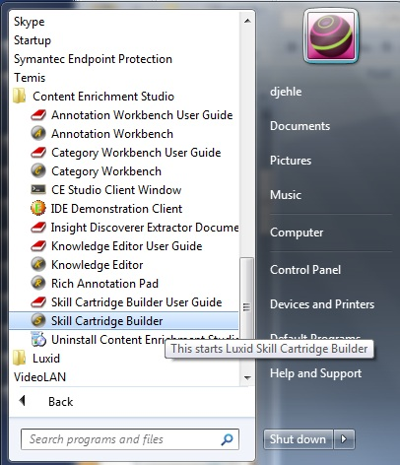
Installation

Slide 56
Skill Cartridge Builder Overview
Compilation tools
Temis Explorer
View for Projects
Extraction View
Testing Skill Cartridges

Slide 57
Installation
Right click in the Temis Explorer
Select Import
Select General / Existing Projects into Workspace / Next
1
3
2

Slide 58
Installation
Specify path to the unzipped folder MobilePhones
Select root directory / browse to unzipped folder
Projects that can be imported are presented
Check the checkbox of the project / Finish
1
2

Slide 59
Installation
Project is now open in the Skill Cartridge Builder
To start working with it, the skill unit must be set to active
Choose Skill Unit / Select active skill unit / Project name
1

Slide 60
Configuration
Before extracting, control or adjust the language settings of the skill unit
Double click on .cartrige folder / move to Skill Unit tab (on the bottom) / click on Skill Unit / set languages

Slide 61
Agenda
Installation
Importing a new Skill Cartridge Builder project
Test Skill Cartridge
Enhance Skill Unit with a new relation
Package .sca file

Slide 62
Packaging your Skill Cartridge®
Package your Skill Cartridge to test it
Every time you save changes in the Skill Unit or Skill Unit component files the cartridge will be compiled to a SCA file internally (if incremental compilation is toggled)
This may lead to errors, which have to be resolved before the cartridge is useable
Check for errors in active Skill Unit
Compile Skill Cartridge manually (unnecessary if automatic and incremental toggled)
Automatic and incremental compilation toggled

Slide 63
Compilation for first use
Compile the active Skill Unit
Compilation without a save, i.e. in the case of first use, can be induced manually, by pressing this button
Now the Skill Cartridge should be compiled (it will not, if errors exist) and ready to extract

Slide 64
Installation
Make a quick extraction test to ensure the Skill Cartridge is ready to use
Change to extraction view
Connect to Studio IDE / choose Skill Cartridge
Enter some text about mobile phones and press ‘extract’

Slide 65
Enhance Skill Unit
Creation of a new relation
Mobile phone manufacturer‘s market share
We want to extract the percentage of the market share for a mobile phone manufacturer as a relation
Huawei held a 4% share of the global smartphone market in the fourth quarter, making the company the world's sixth-largest smartphone vendor, according to market-research firm Strategy Analytics.

Slide 66
Modification
Open the Skill Unit .scu file
Add a new Skill Cartridge component reference
‘<include ref=‘’MarketShare-patt-en.scp’’ />’
A warning will appear and you cannot compile the Skill Unit until the file is created

Slide 67
Modification
Create a new file ‘’MarketShare-patt-en.scp’’
Choose new Skill Unit Component file
Navigate to the corresponding Project/su folder
Name it ‘’MarketShare-patt-en.scp’’
Now you can compile the Skill Unit without errors

Slide 68
Modification
If this view is open, change to ‘Source’ tab to get the XML editor

Slide 69
Modification
!
Edit ‘MarketShare-patt-en.scp‘
Insert name and language of the component file in the component tag
Otherwise the scp file will not have access to entities, macros or annotations of other .scp files
<component name=“Patterns” language=“english” ...>

Slide 70
Modification
Edit ‘MarketShare-patt-en.scp‘ and insert
Definition of MarketShare trigger verb
‘hold’ is the verb that suggests a market share relation, so we need to find it
Definition of MarketShare percentage
The percentage of the market share should be part of the relation, so we need to match it
<annotation name=“MarketShare-trigger-VB" display=“never">
<e>hold</e>
</annotation>
<annotation name=“MarketShare-percentage" display=“never">
<e>[0-9\.\,]+ / %</e>
<e>[0-9\.\,]+%</e>
</annotation>

Slide 71
Modification
Edit ‘MarketShare-patt-en.scp‘ and insert
Definition of relationship concept ‘Market_Share‘
The relationship market share will contain a subject, which is the manufacturer and referenced from the existing Skill Unit components, the trigger verb, a determiner, the percentage as an attribute and the market share expressen, also referenced from other Skill Unit components
<concept name=“Relationship" level=“10" display=“always">
<concept name=“Mobile_phone“>
<concept name=“Market_Share“>
<e>
{/Role/Subject: ~User~Manufacturer-lex} /
~MarketShare-trigger-VB / #DET / {/OA/Percentage:
~MarketShare-percentage} / ~~MarketShare
</e>
</concept>
</concept>
</concept>

Slide 72
Modification
Note
If you have copied and pasted the definitions from this presentation, make sure to substitute the quotation marks in the Skill Unit Component File

Slide 73
Final MarketShare-patt-en.scp

Slide 74
Test Extraction
Save project, compile active skill unit (if incremental compilation is off) and test extraction

Slide 75
Package Skill Cartridge
To package the enhanced Skill Cartridge
Press ‘Export SCA of cartridge containing the active skill unit‘
Choose output name and location
Click ‘Export‘ to finish

Slide 76
More Information
More information on writing Skill Cartridges can be found in
IDE Skill Cartridge Author Guide
“Training AKP SC Building” slides (Tutorial to build MobilePhones Skill Cartridge)
The completed Skill Cartridge “MobilePhones_completedproject” is available as
A project to import into Skill Cartridge Builder
A readily compiled Skill Cartridge file (.SCA)

Slide 77
Workshop Agenda
Scenario 4
Modelling a scenario with machine learning → Create a training corpus in the “Annotation Workbench”
Some scenarios may be hard to model with explicit rules
Alternative: Annotate examples of the things that need to be extracted and let an algorithm infer a model

Slide 78
A Machine Learning experiment
Let‘s try to learn vague sentiment around entities in news articles
What‘s the image of the „Piratenpartei“ in the press
„wenn schließlich mit den Piraten nichts anzufangen ist , und danach sieht es auch aus, dann könnte eine FDP …“ → negative
„… und der schnelle Aufstieg der deutschen Piratenpartei wecken in Frankreich erstaunte Aufmerksamkeit …“ → positive
Decisions of this type are often not easy to encode explicitly
(and require considerable expertise in rule coding)
… but manually tagging examples is relatively simple
(requires only common sense - and some time …)

Slide 79
Adapt TERMAL in Knowledge Editor
Connect KE to the database
Create a new project, here „Piraten“
And assign the (previously installed) TERMAL SC to the project (right-click)

Slide 80
Feature engineering
Some criteria that can be assumed to be relevant for the learning algorithm.
MLX comes with a rich set of predefined features

Slide 81
Feature engineering
Criteria used as features

Slide 82
Feature engineering
Regular expression: Some uppercase letter anywhere inside
A criterion (see „Entity/Binary“)
… will lead to many features (see „Configuration/Features“)
This line generates 5 features: Does the second to last token contain an uppercase? The last? The token itself? The next? The one after that?

Slide 83
Assign & Synchronize
We now have a ready MLX SC … but it is still untrained!
Assign the features, lexicon and static mapping to the SC‘s proper entry points.
Then press „Synchronize“

Slide 84
Annotation Workbench
Open AWB and connect to workspace
Create a new project, here „Piraten“
And import text documents into it

Slide 85
Define your entities
We want to tag the „Piratenpartei“ according to whether the author portrays them positively or negatively so let‘s create entity types for that.

Slide 86
And annotate … and annotate … and annotate…
Now manually go through the corpus and add the proper type in ALL and ONLY those places where we have (pos or neg) occurences of the „Piraten“. This may take a while …
When you are done (all documents in the corpus annotated), press „Learn“ on your corpus

Slide 87
Was it any good?
The TERMAL SC does some internal book-keeping on the learning success. Open with your browser the „../MLreport/html/index.html“ file and click on the latest report …
TERMAL informs us about the latest training success on 10% of unseen training data …

Slide 88
Result feels, smells, tastes like a „normal“ SC
Resulting TERMAL SC can be used like any other SC to annotate documents …

Slide 89
Assessment
The experiment took
~2h for the annotation of ~100 news articles
~5min of ML training
… and returned encouraging results on a question that is certainly non-trivial to model with explicit rules
The TEMIS ML approach MLX can be a valid foundation for addressing interesting information extraction questions

Slide 90
Remarks
Algorithm inside: Conditional Random Fields
cf. http://www.inference.phy.cam.ac.uk/hmw26/papers/crf_intro.pdf
Be creative in designing appropriate features!
Lexical clues? Regular expressions? Existing SCs …
Important question:
Which kind of task can be better handled with Machine Learning?
Which ones are better suited for traditional SCs?
How much annotated data is enough?
100 training examples? 1000? 10000?

Slide 91
Remarks
Make sure that training data is representative
If the training corpus contains only cases where the „Piraten“ are critizised, MLX may learn just that
Add positive, negative (and neutral) examples

Slide 92
Scenario 5
Benefitting from the Luxid Community: Skill Cartridges set up by third parties

Slide 93
Skill Cartridges as a marketable good
Analogy: A Smartphone App
Win-Win-Win: More choice for the user, new marketing channel for the App developper, increased platform reach for the vendor
Examples:
SCAI: Joint development of an SC for Protein name recognition
Elsevier: Joint development of an SC for Chemical Name Recognition
WTI Frankfurt (formerly FIZ Technik): TEMA Thesaurus on Engineering
Perspective for Luxid users:
Obtain SCs not only from TEMIS or based on in-house efforts but also from efforts in the community
Offer your own thesauri to third parties!? (Linking back into arbitrary inhouse locations, Topic Pages, etc….)
TEMIS “Luxid Community Marketplace” at http://community.temis.com

Slide 94
Conclusion
Luxid: A platform to model many different extraction scenarios
Simple approaches for simple cases
Sophisticated approaches for more difficult cases
Process of creating & modifying Skill Cartridges supported by dedicated tools
Scenarios and requirements for Content Enrichment are diverse and offer opportunities for Skill Cartridge development activities

