Slide 1

Semantic content enrichment and techniques for extraction of relevant relation (part 2)
Presentation of several uses-cases, their link to the Big Data and NLP community
Charles Huot & Stefan Geissler
Institute for Bulgarian Language, Bulgarian Academy of Sciences
Sophia March 5th, 2014

Slide 2

It’s all about languages, isn’t it?

Slide 3
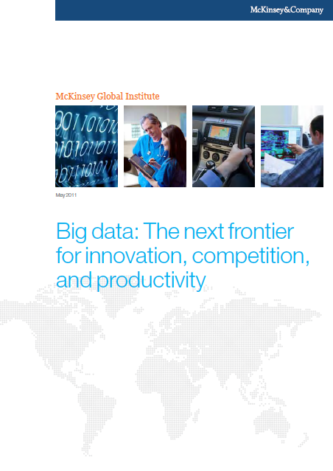
McKinsey Global Institute: « Big data: The next Frontier for innovation, competition, and productivity

Slide 4
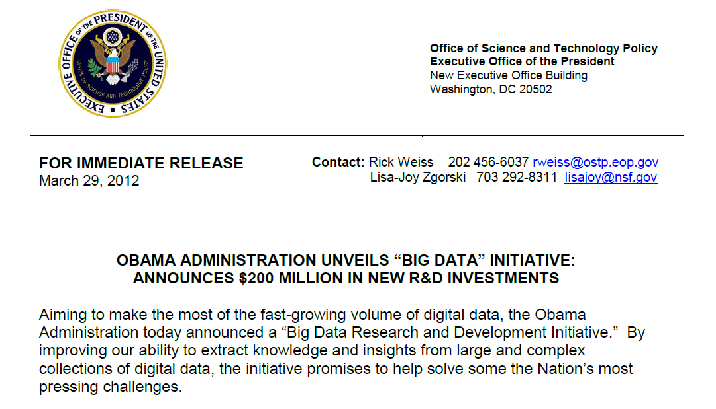
« Nation’s most pressing challenges »

Slide 5

More Data, much more

Slide 6
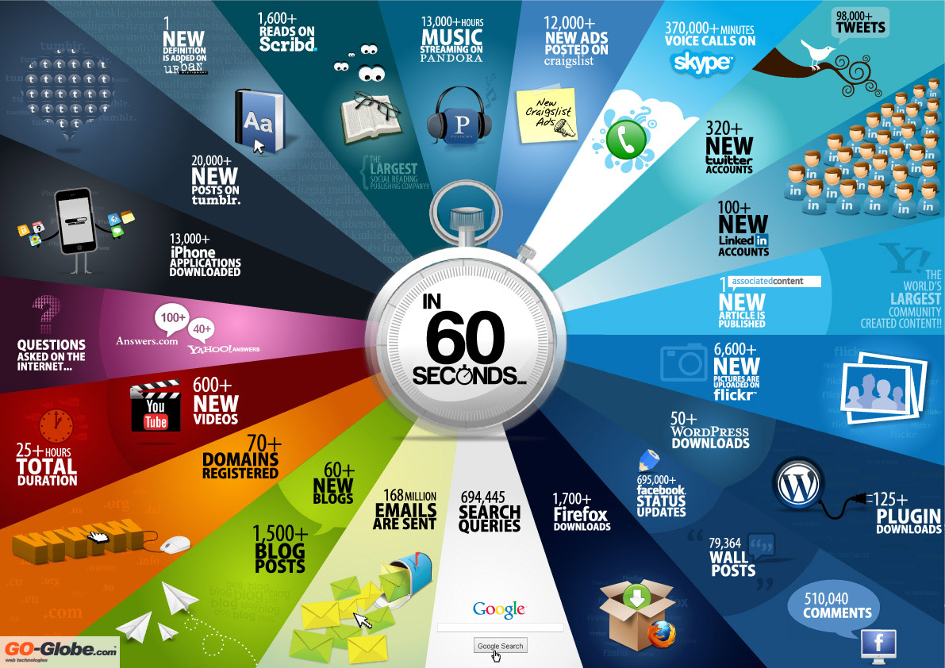

Slide 7


Connected Cows

Slide 8
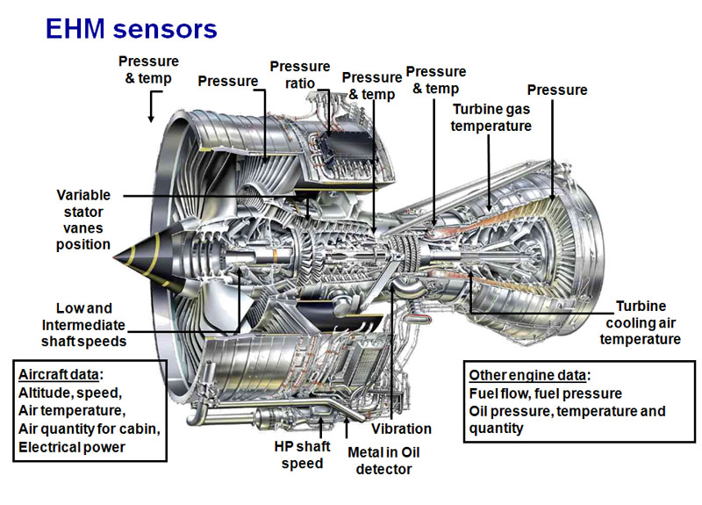
Sensors on airplane engines

Slide 9

Sensors to monitor the trafic and more in town

Slide 10

Collecting data from the Universe

Slide 11
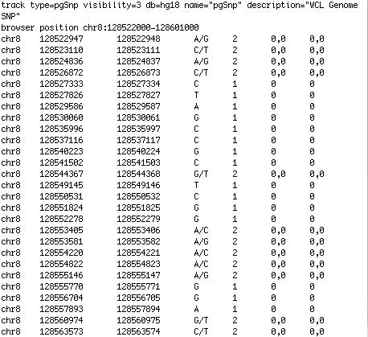
Génome
Decoded Genome

Slide 12
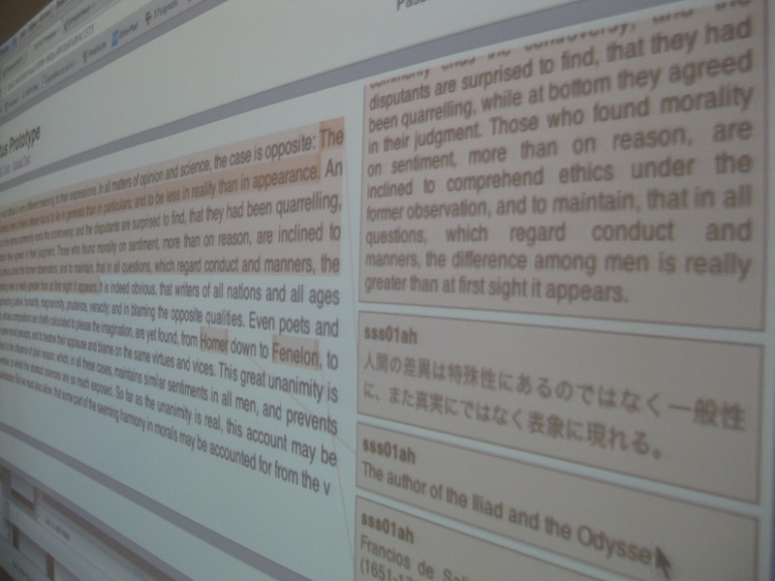
Crowd Sourcing

Slide 13

Play, Buy, communicates and leave numerical data in all places

Slide 14
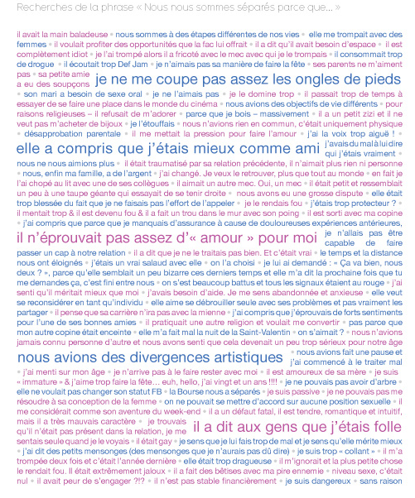
Talk about ourselves and others

Slide 15
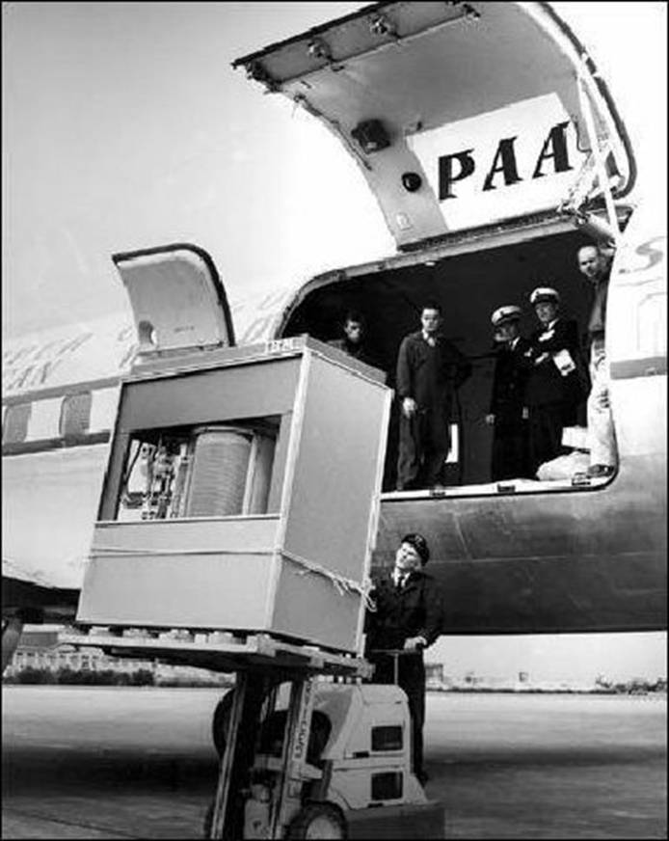
Size Matter, but it’s not the only criteria !
1 Tone of electronic equipment
The largest Hard Drive
Of the IBM latest generation computer, the “305 RAMAC” in 1956, with 5Mo capacity

Slide 16
More applications to manage
Watson
Predictions
Investment Trend
Detection
Gov’t Intelligence
Apps
Decision support
Fraud
Detection
Climate Modeling
And Prediction
Voice of Customer
Sentiment extraction
Number & complexity of
technologies/data sources
eDiscovery
Relationship
Detection
Reputation
management
Brand
management
Find influencers
Find drug
interactions
Alerting
Ad targeting
Pattern
Detection
Log Analysis
Smarter
Planet
Churn detection
eCommerce
Historic
Time Frame
Future(Predict)
Source: IDC, Big Data and the information advantage
Sue Feldman

Slide 17


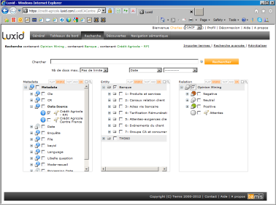



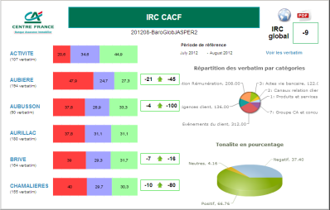

Solution d’analyse des verbatim clients
3. Restitution
Surveys
Multichannels feedback
collection
Experts
2. Verbatim Analysis
Verbatim
Customers
IT
Users

Slide 18
La plateforme Luxid
Luxid Annotation Factory, chaîne de traitement en langage naturel.
2. Analyse des verbatim
Verbatim
SC
SC
SC
SC
A
B
O
P
Skill Cartridges® Anonymisation
Skill Cartridges®
Métier Bancaire
Skill Cartridges®
Analyse Opinions
Skill Cartridges®
Propos Diffamatoires
Content Enrichment Studio
Experts

Slide 19
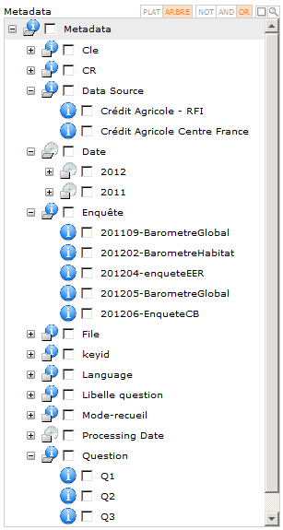
Meta data Structuration
Metadata attached to verbatim are 4 types :
données qualifiant la nature de la source, le mode de recueil, la date, le type d'enquête, le marché, libellé question
données recueillies lors de l'enquête : note et verbatim
données d'identification du client s'il y a levé l'anonymat
données de localisation de l'agence du client

Slide 20


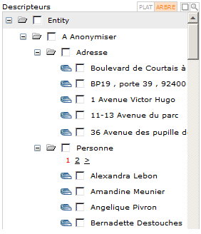



1. Anonymisation of content
SC
A
Skill Cartridges® Anonymisation

Slide 21
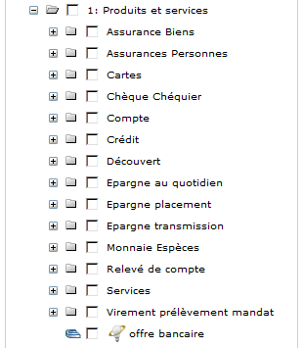
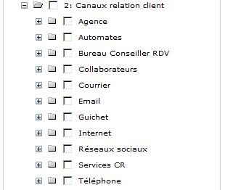
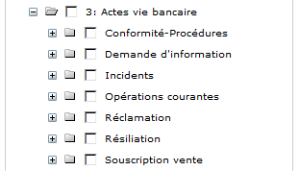

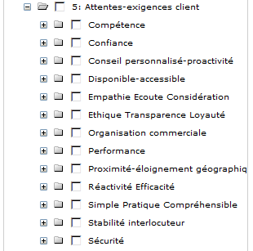
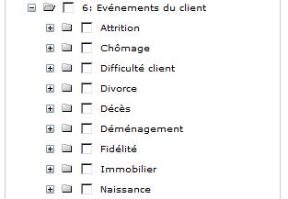
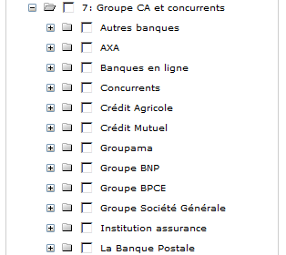
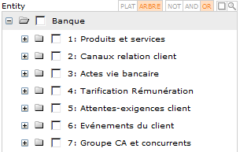
2. Banking Business Model
*
SC
B
Skill Cartridges®
For Banking

Slide 22

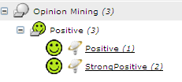

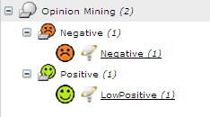
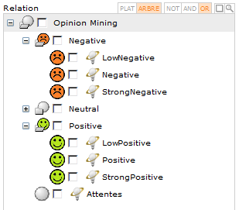

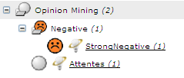
3. Opinions Mining
Sentiments detection
SC
O
Skill Cartridges®
Analyse Opinions

Slide 23
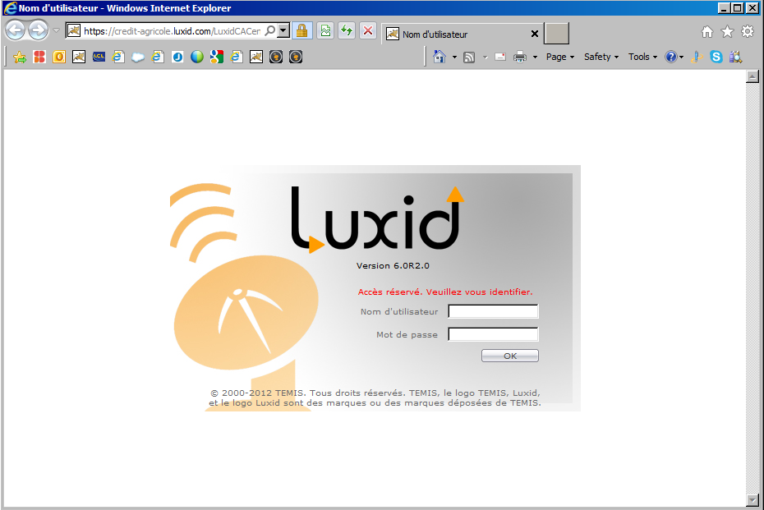

Slide 24


Slide 25
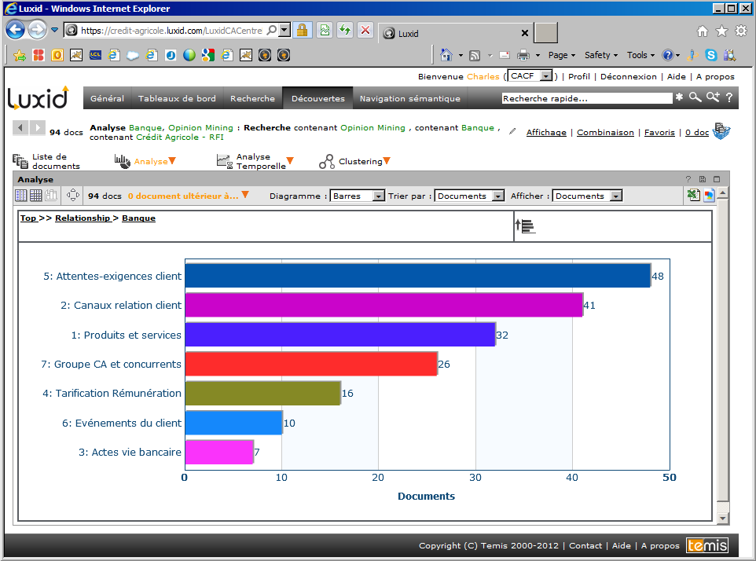

Slide 26
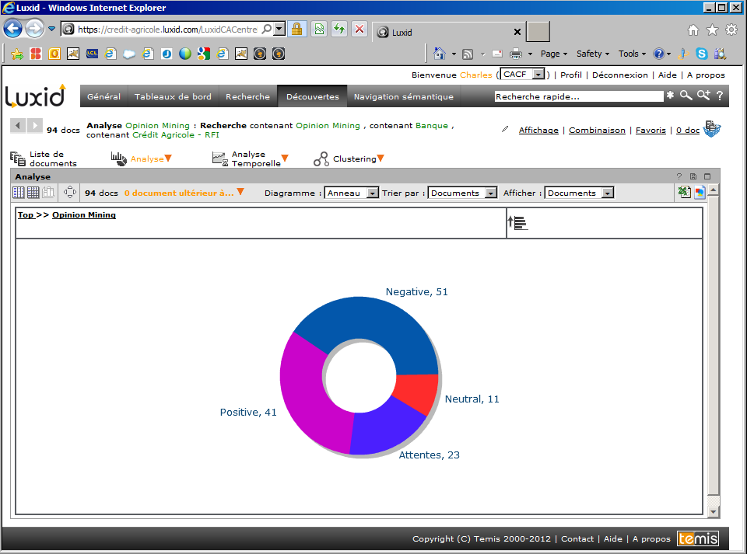

Slide 27
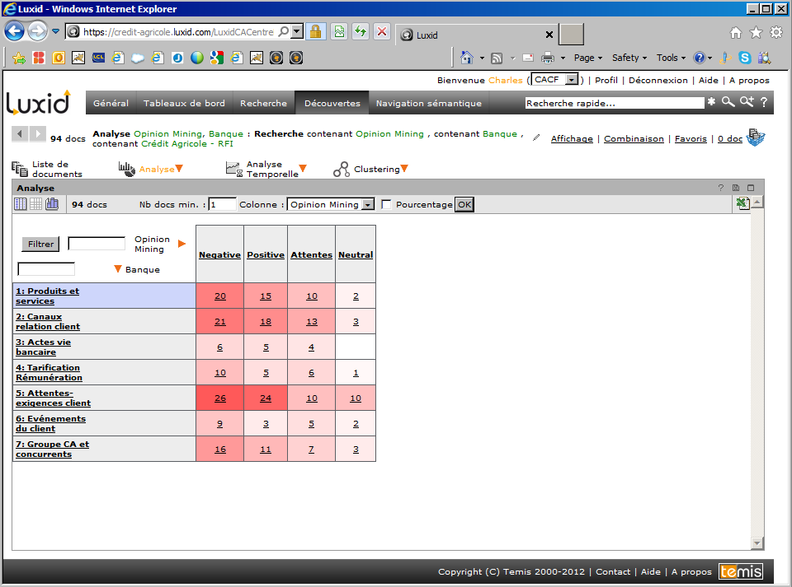

Slide 28

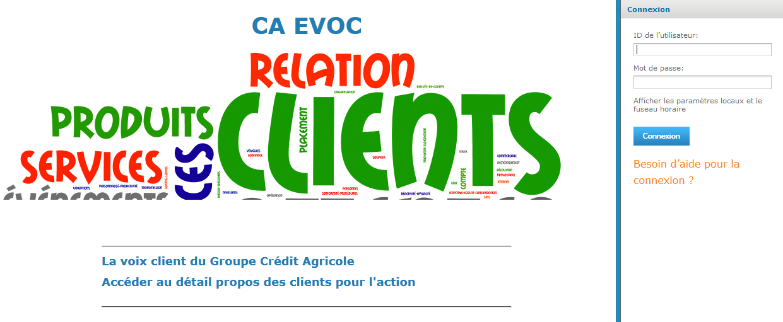

Slide 29
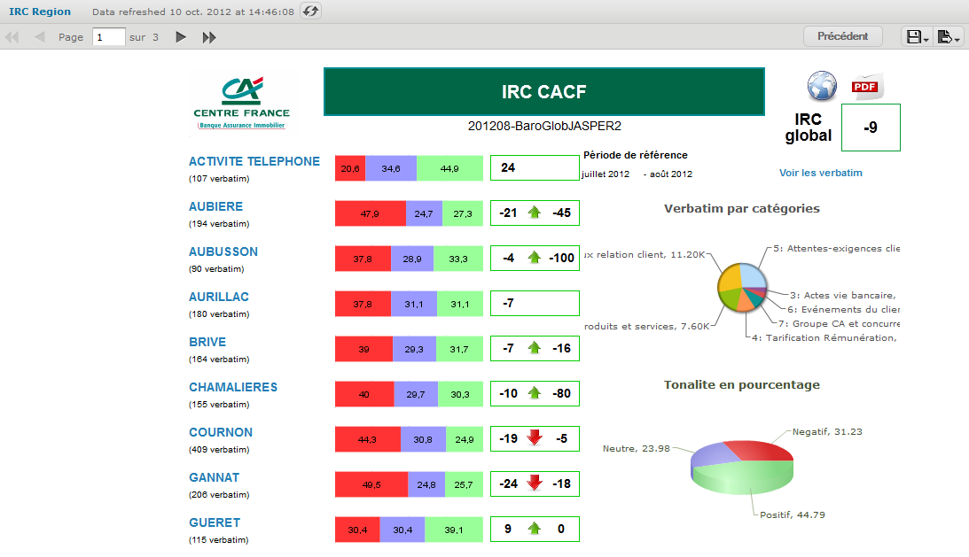

Slide 30
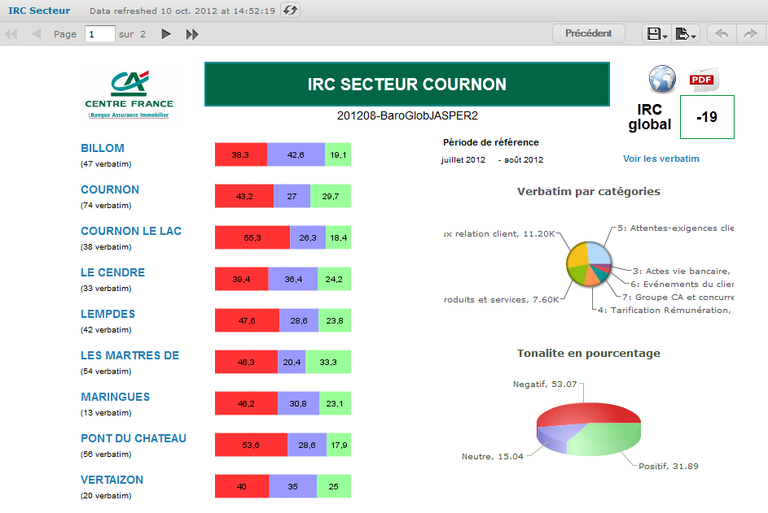

Slide 31
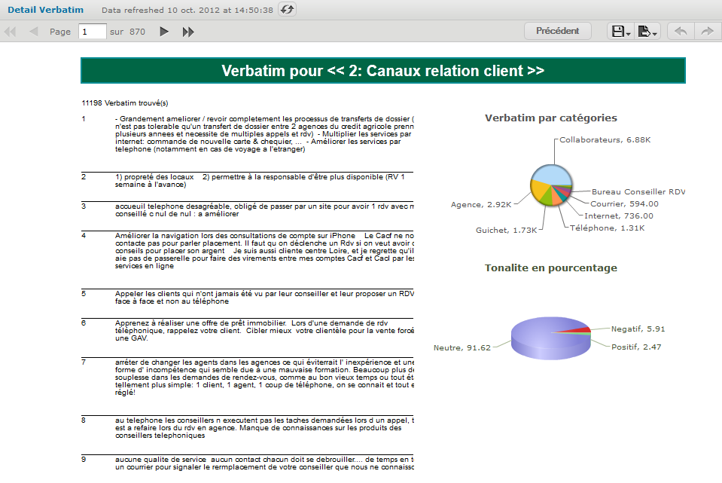

Slide 32
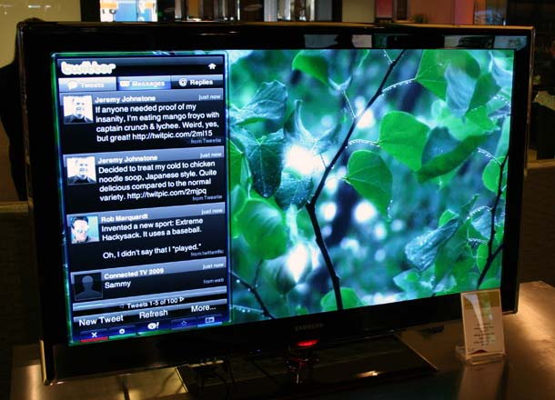




TV & Twitter

Slide 33
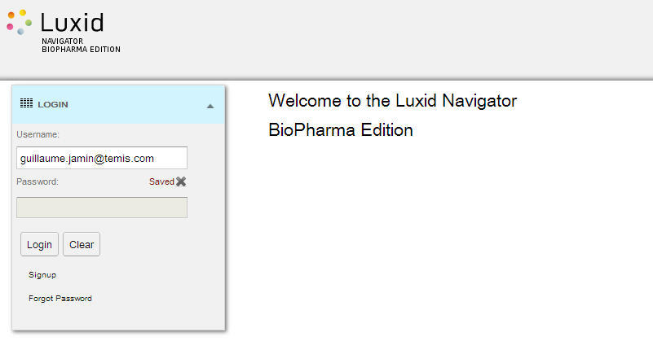
Luxid Navigator Biopharma Edition:
Big Data & Open Data

Slide 34
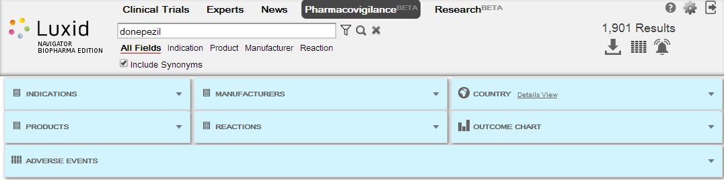
Pharmacovigilance
Source actuelle : FDA Adverse Events Reporting Systems
Possibilité de filter :
-Indications -Products
-Manufacturers -Reactions
-Countries -Time

Slide 35
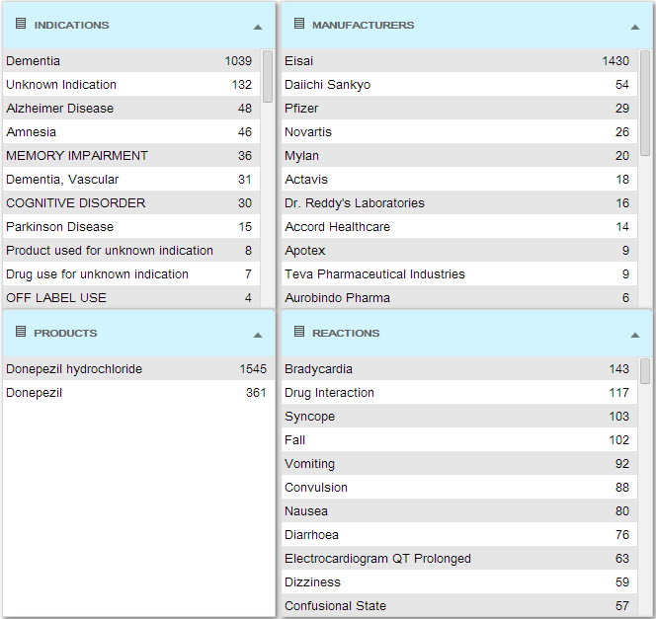
Pharmacovigilance

Slide 36
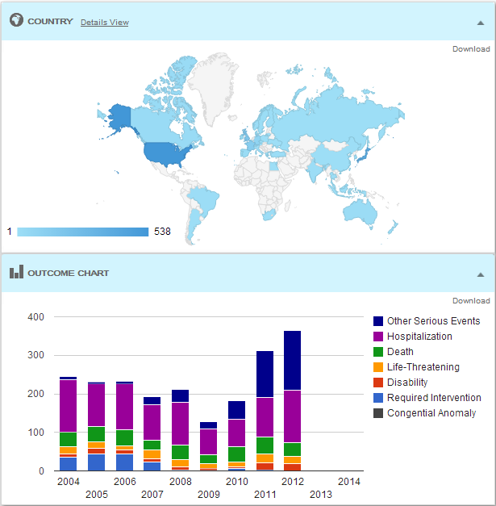
Pharmacovigilance

Slide 37
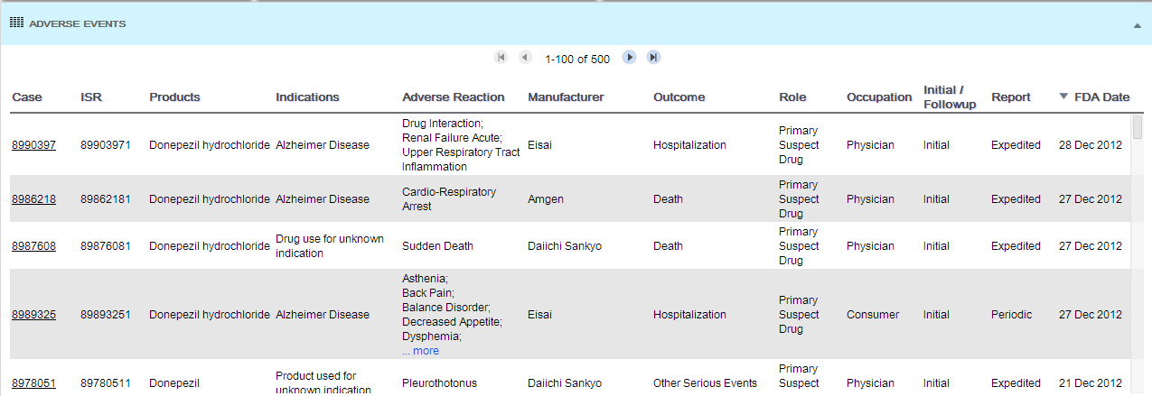
Pharmacovigilance

Slide 39
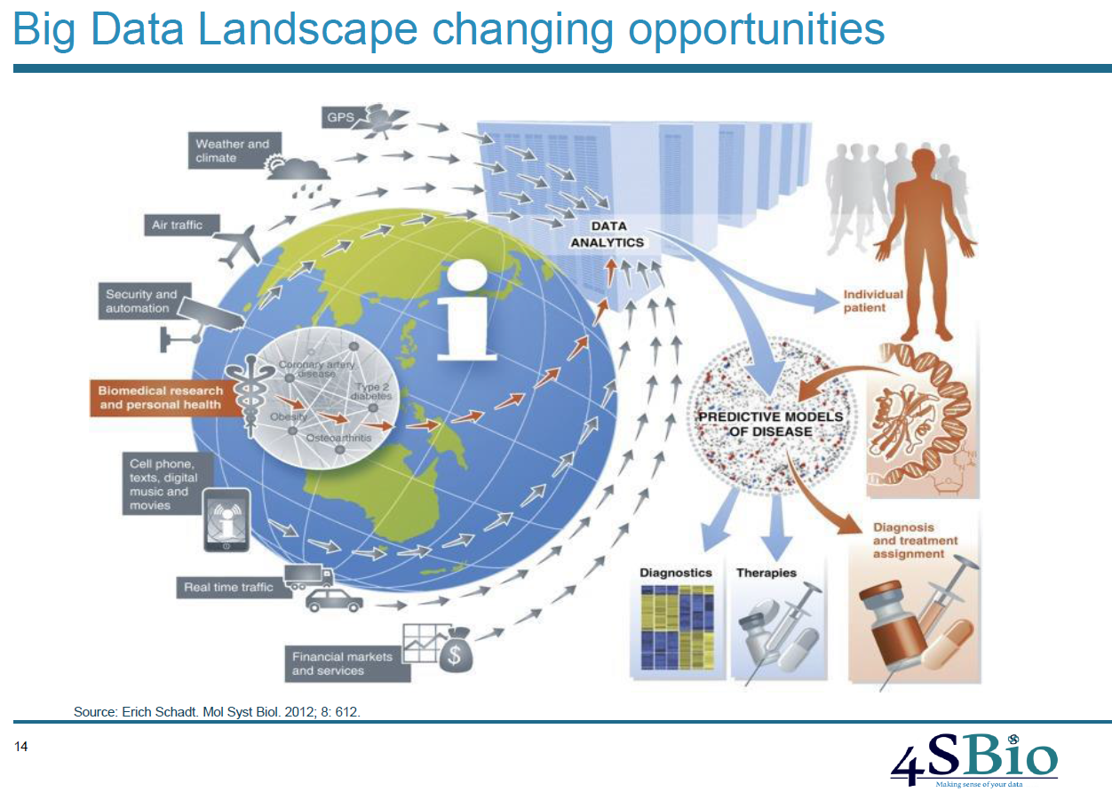

Slide 40
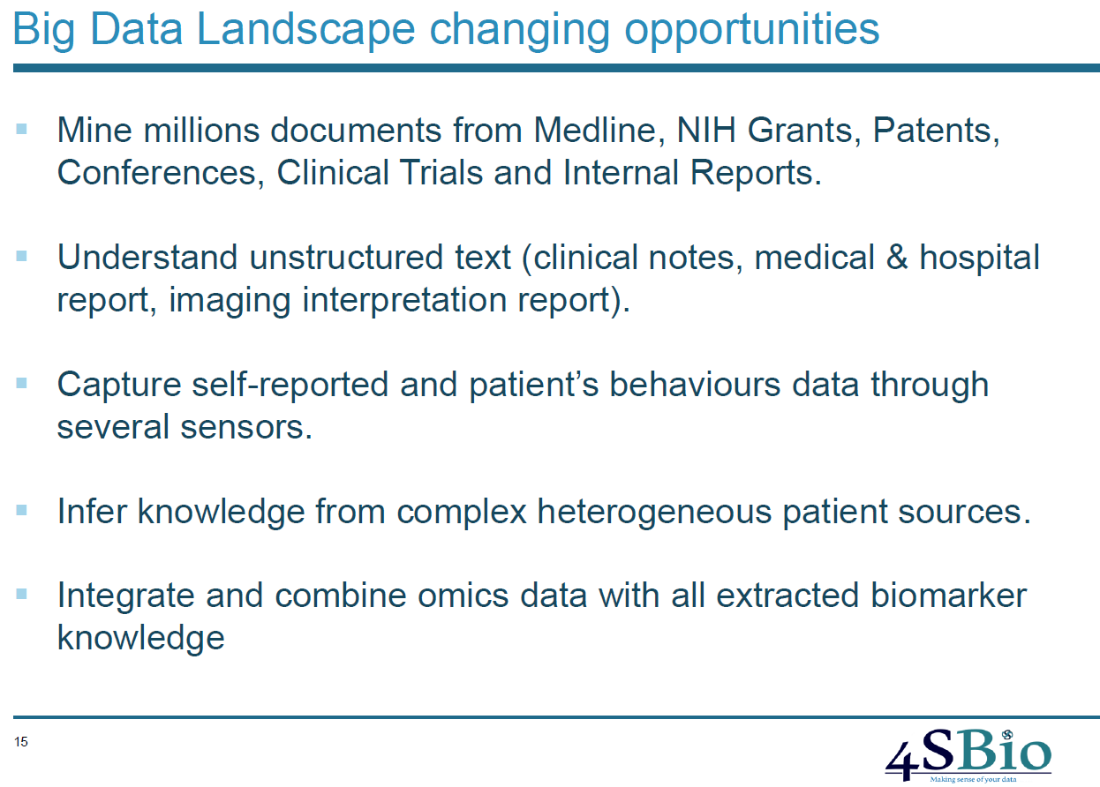

Slide 41
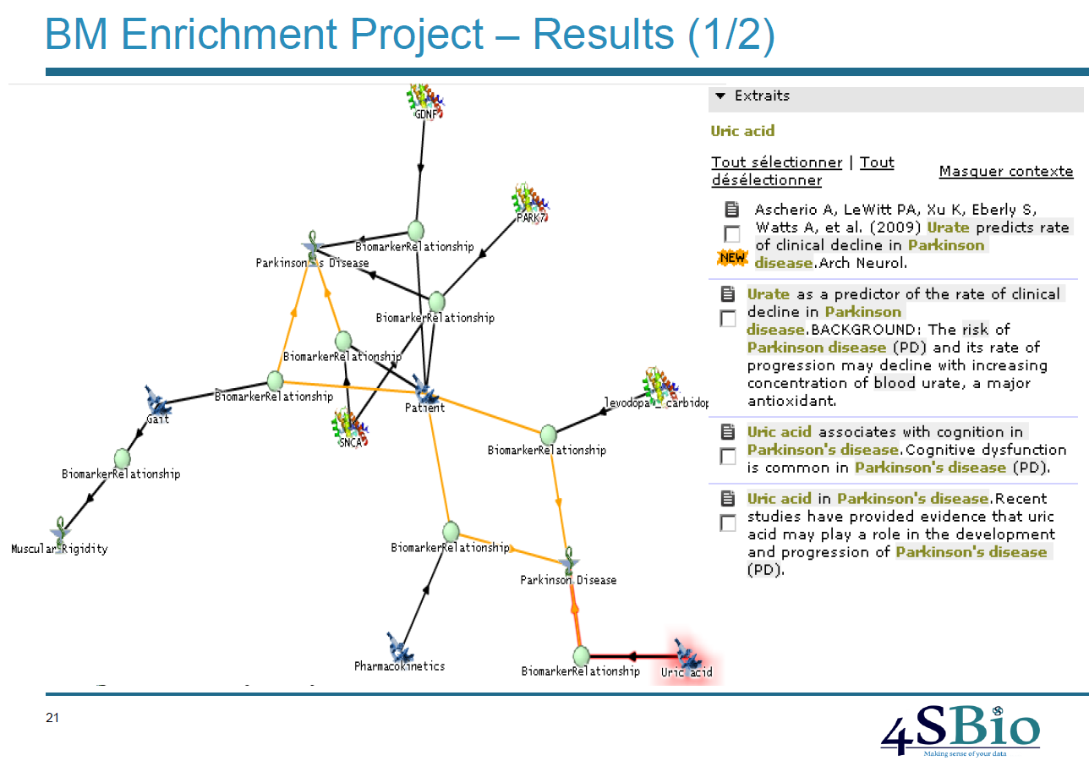

Slide 42
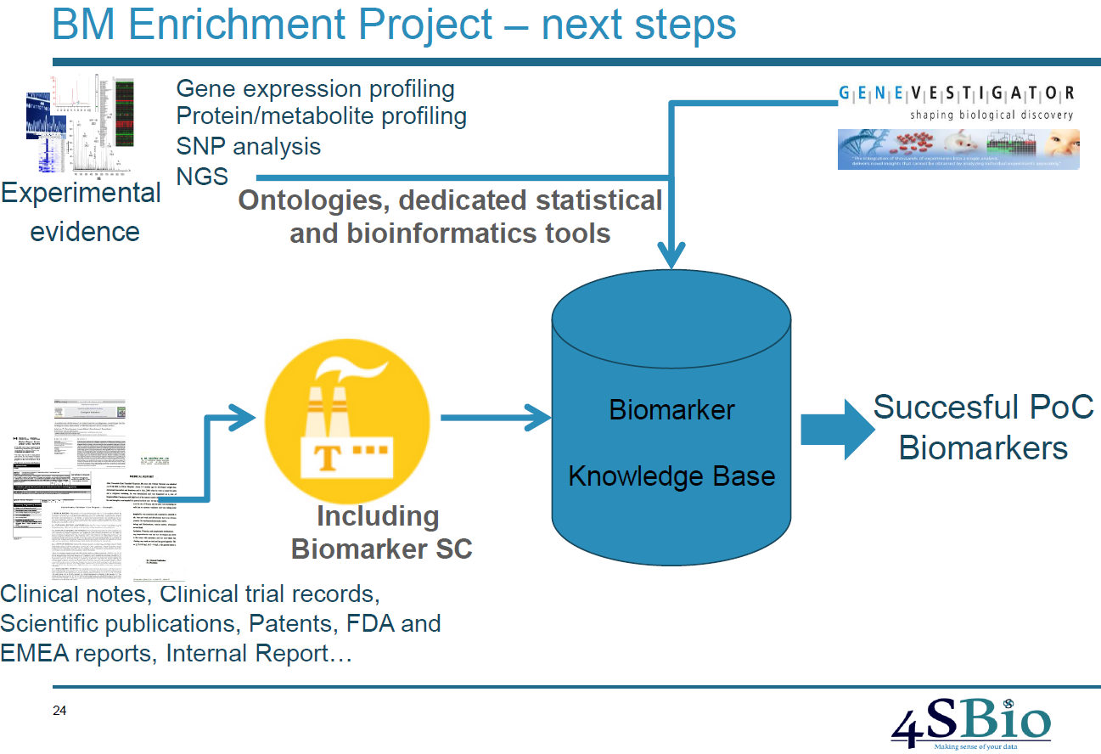

Slide 43
The success factor?
Emergence of eco-system to ensure data interoperability

Slide 44


The first collaborative semantics platform
Our goal : to create synergies in our ecosystem
Platform
Partners
Service
Partners
Academic Partners
Clients

Slide 45
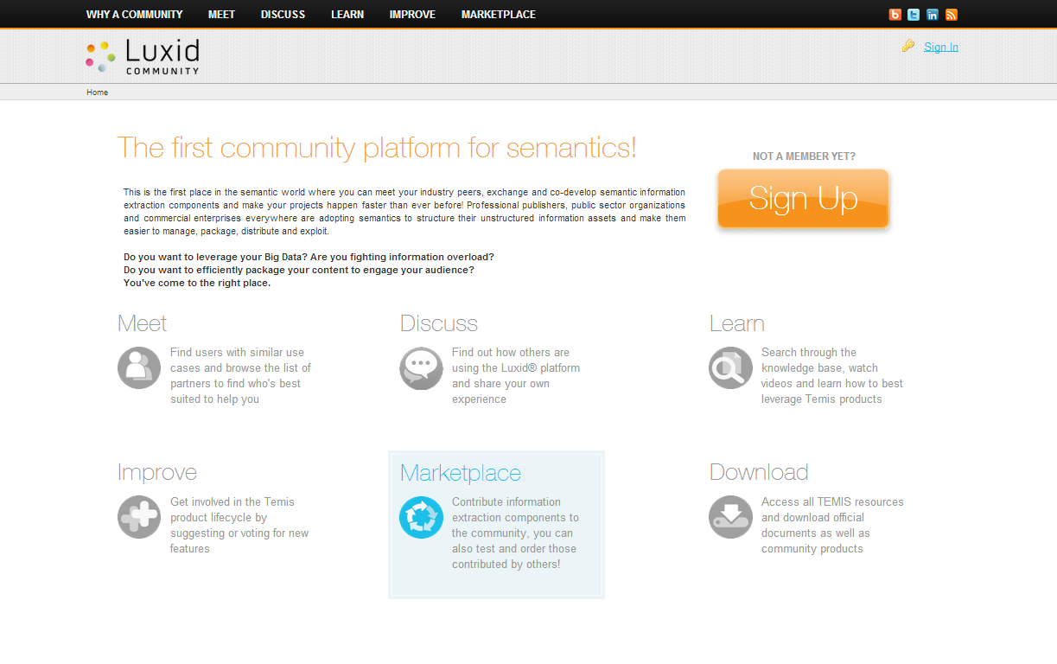

Slide 46
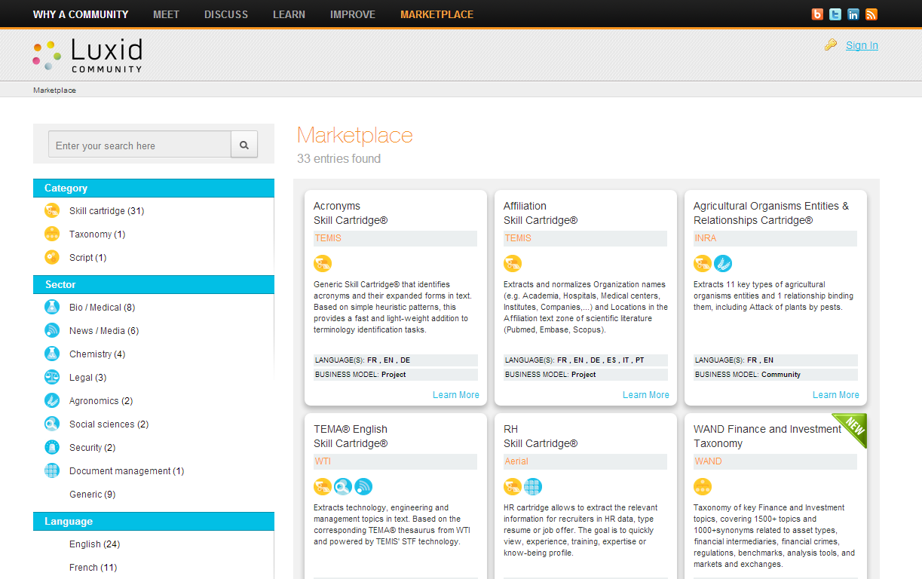

Slide 47
Luxid® Community & LT-Innovate
What can LT-Innovate do to help?
Luxid® is an open platform
Luxid® Community is an open initiative
  Any one can contribute
Platform partner program in place
  Free access to the tools (annotation platform & studio)
  Ability to promote services
  Ability to sell products (CC-By framework)
Contribution from LT-Innovate?
  Join the community to use and evaluate existing resources
  Enrich resource portfolio - post industry oriented thesaurus
  Contribute to Semantics - build and share Skill Cartridges™

Slide 48
Summary
Open the door to the Digital Single Market
NLP is the key
  Provides a language independent knowledge representation
  Skill Cartridges™ as the foundations
Unlock seamless & multi-lingual search & navigation
  Local data (customer interactions, social media, …)
  Global data (technical & scientific knowledge, …)
Unlock data interoperability
  Collaboration between industry & data owner is required
  Luxid® Community as an enabler/accelerator

Slide 49
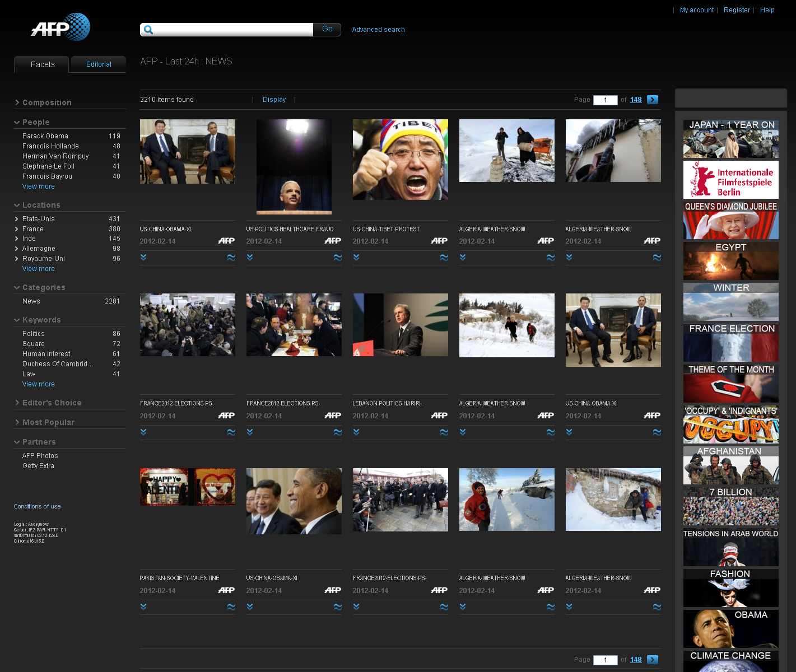

Slide 50
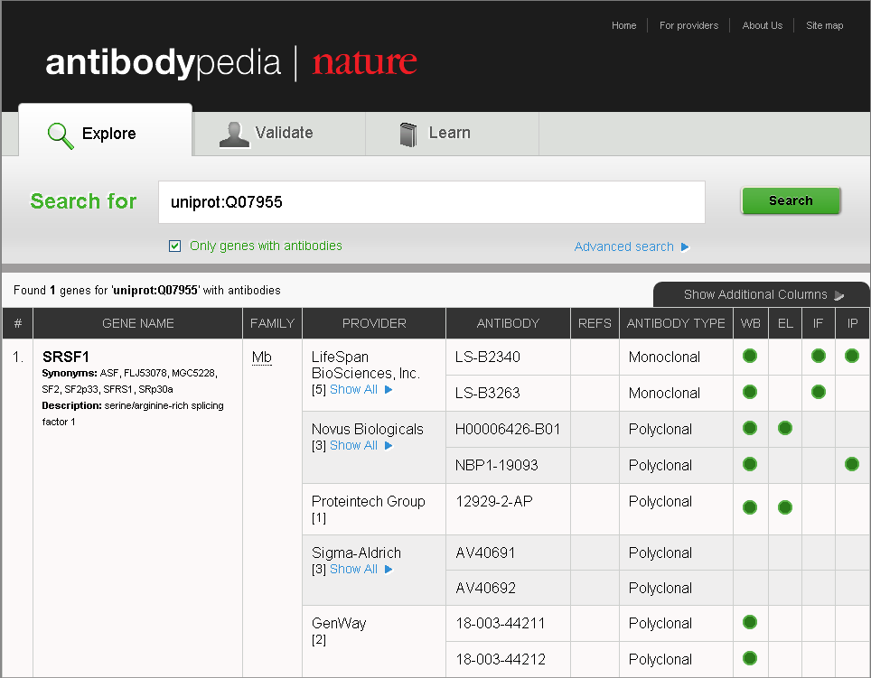
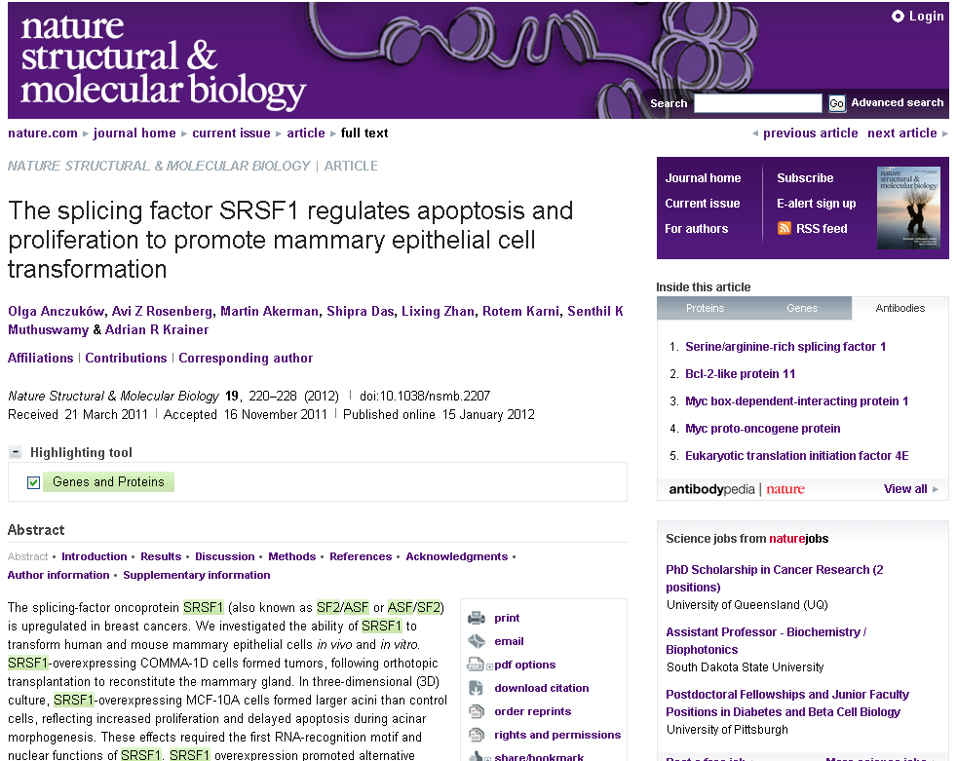
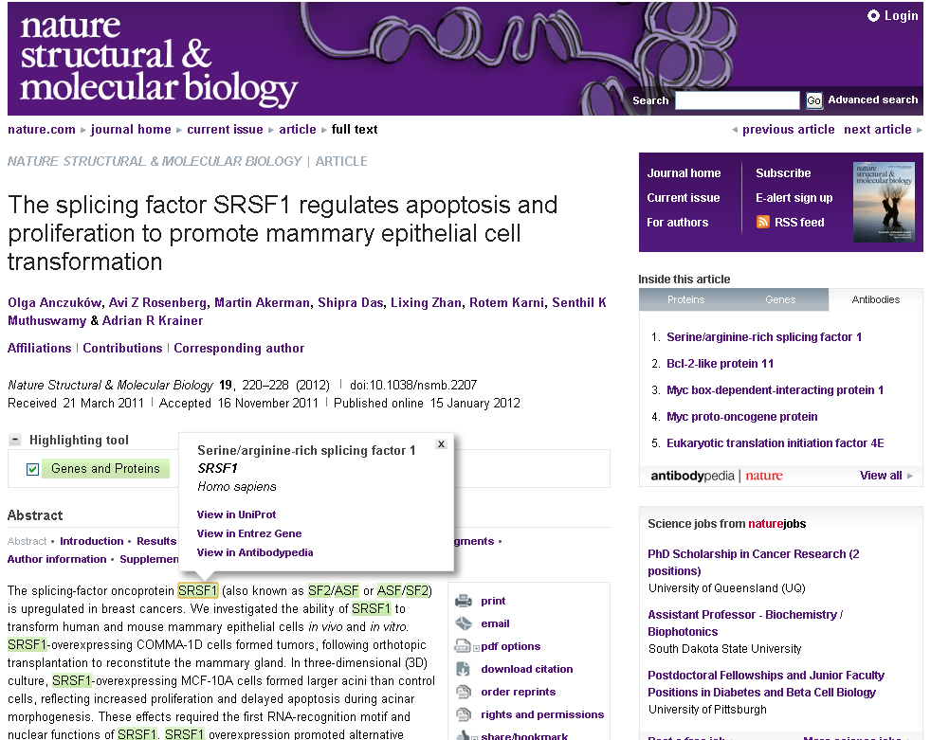
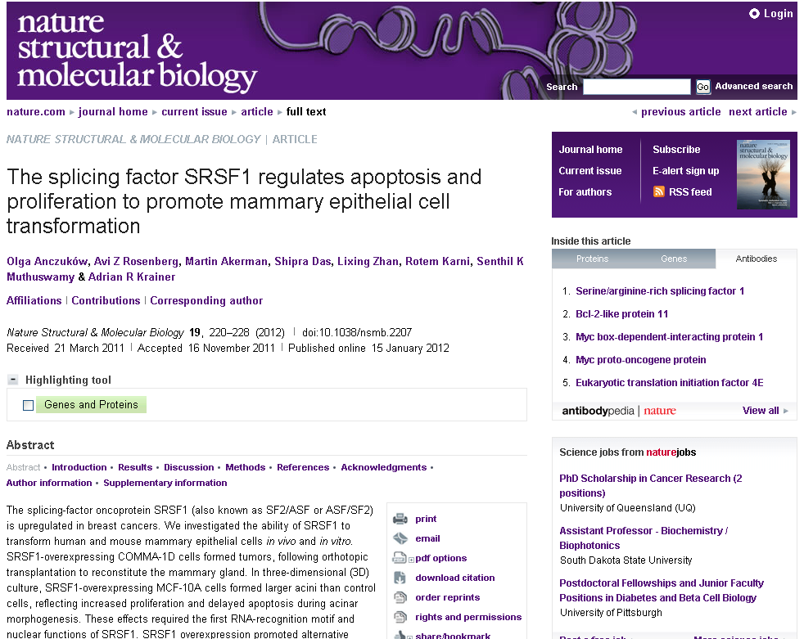
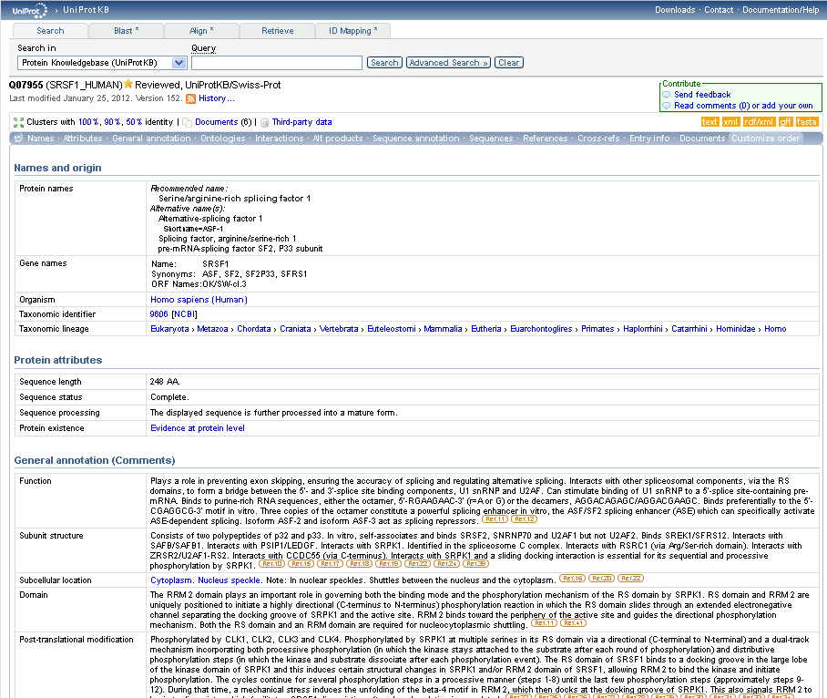

Slide 51
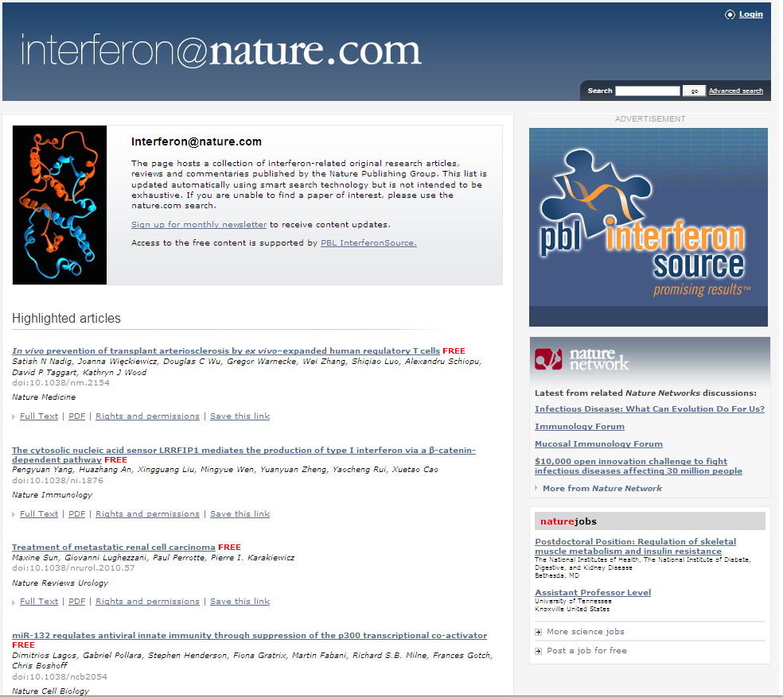

Slide 52


Related Documents Popup
  Links the reader to additional content based on the current document
« Slice and Dice » approach
  Chapters from separate books are available on an individual basis

Slide 53

Commercial Rents (size, location, facilities, time, region, ...)
Alimony/Child support (income, marriage, children, region, ...)
Labor Law (age, company size, location, industry, region, …)
Damages (the type of loss, circumstances, region, ...)

Slide 54


Querying the Knowledge Base
topic Labor Law subtopic Accidents in the workplace
Type of disability
Date of decision
Court
Age
Gender
Damages paid
Profession
Each
extracted
concept
has become a
search
criteria
Type of accident
Severity of the disability
Cause
Part of body

Slide 55


Geographical Query
Innovative geographical outline-based query mechanism
Goes beyond conventional search
Makes use of address extractions to focus on geographical area of interest

Slide 56


Geographical Query - results
Innovative geolocalized results
Goes beyond conventional and flat search results list
Makes use of address extractions to locate decisions on the map

Slide 57

Navigating Query Results
Decisions matching the search criteria
Facets based on the same concepts
enable efficient drill-down within the document set

Slide 58

Navigating within 1 query result
Enhanced experience with accelerated navigation
Semantic shortcuts accelerate navigation
Key concepts highlighting

Slide 59


