Slide 1
E-dictionaries of MWUs
Cvetana Krstev
University of Belgrade
Faculty of Philology

Slide 2
Outline
About compounds
Collecting compounds
Inflection of compounds
Production of lemmas
More information

Slide 3
What are compounds?
They are sometimes called multi-word units (meaning almost the same).
Multi-word units are hard to define controversial linguistic objects.
Many authors agree that multi-word units:
  are composed of two or more graphical words;
  they show some degree of morphological, syntactic, distributional, or semantic non-compositionality; and
  they have unique and constant references.

Slide 4
Multi-word units in NLP
However, even the notions appearing in the previous definition – e.g. what is non-compositionality, constant references, as well as a degree of non-compositionality are controversial.
When dealing with multi-word units we are taking a pragmatic approach and consider as multi-word units contingent sequences of graphical units that for some reason have to be described and processed as a unit.
This means that compounds need not be either syntagms or established terms that are usually listed in general or terminological dictionaries (but can be that as well).
Phrasal verbs are not considered compounds because (among other things) they do not normally satisfy the condition of being “contingent sequences”.

Slide 5
Why are compounds important?
They are useful and crucial for all phases of text processing
For instance, compounds are useful for morhological disambiguation
  Look at a sequence
  Put oko sveta za osamdeset dana
  Around the World in 80 days

Slide 6
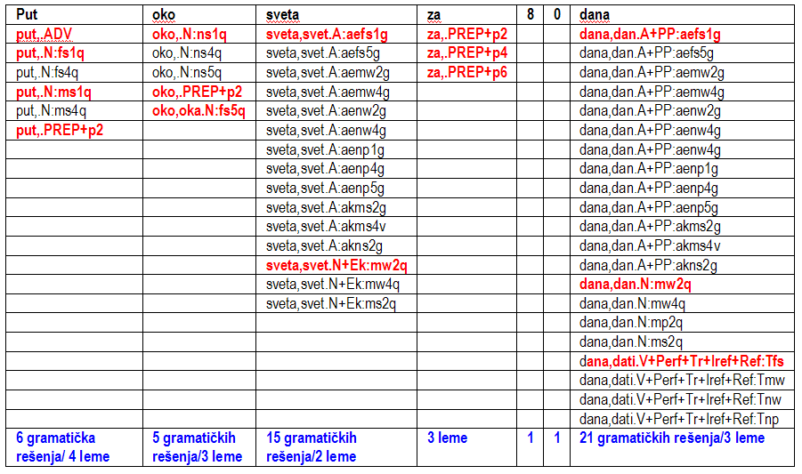
An example

Slide 7
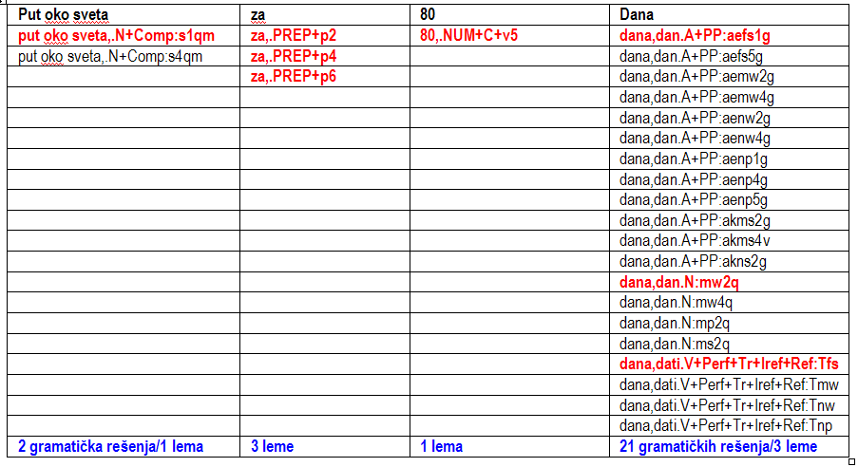
A reply

Slide 8
Outline
About compounds
Collecting compounds
Inflection of compounds
Production of lemmas
More information

Slide 9
How can one collect entries for a dictionary of compounds?
Consulting traditional general and specialized dictionaries, terminological lists, etc.
Search in a text with useful patterns, like
  <A+Col> <N> (an adjective representing a color + a noun).
Some examples of compounds with a color plav ‘blue’ that are already in a Serbian dictionary of compounds:
  plavi patlidžan
  plavi voz
  plavi šlemovi
  plava krv
  plava grobnica

Slide 10
Some more useful patterns
<A+Zool> <N> - an adjective derived from an animal name + a noun. Some examples,
  zečja usna
  mišja rupa
  medveđa usluga
  labudova pesma
<A+PosQ+Top> <N> - an relational adjective derived from a geographic name + a noun. Some examples with the adjective francuski ‘French’ are:
  francuski ključ
  francuski prozor
  francuska sobarica
  francuski krevet
  francuska salata
  francuski poljubac
More patterns during lectures on local grammars

Slide 11
Outline
About compounds
Collecting compounds
Inflection of compounds
Production of lemmas
More information

Slide 12
Inflection of compounds
A very complex task. Why?
  Compounds have several components – some of them inflect, and some of them not. Whether they inflect or not depends on the component itself – a simple word – but also on a role a component has in a compound (e.g. seks bomba or kristal šećer vs. kasica prasica).
  if a component inflects, rules for the inflection of a simple word are applied to it, but not necessarily; for instance, a simple word can have plural forms, but when entering into a specific compound it does not have plural forms.
  if more then one component inflects what rules of agreement apply?
  are some components optional?
  can some components change order in a compound?
  Can some components change their form (abbreviated, lower/upper case, etc.)
  How to deal with compounds in a consistant way, similar to simple words?

Slide 13
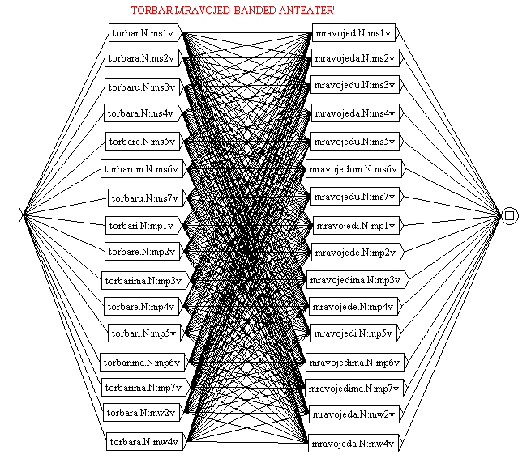
Inflection of compounds – an incorrect solution
torbar mravojed
marcupial anteater

Slide 14
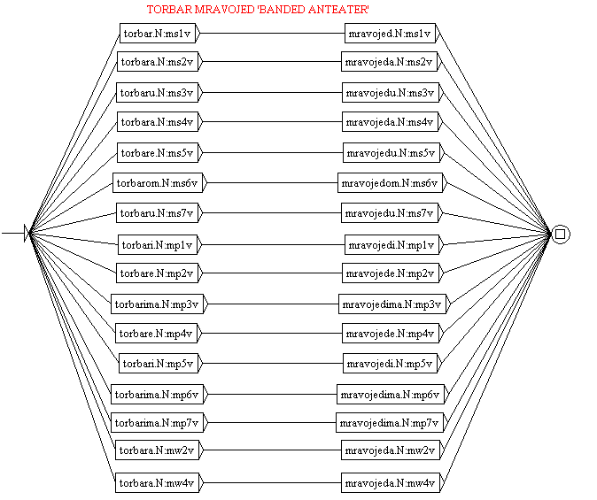
Inflection of compounds – a correct but ineffective solution
torbar mravojed

Slide 15
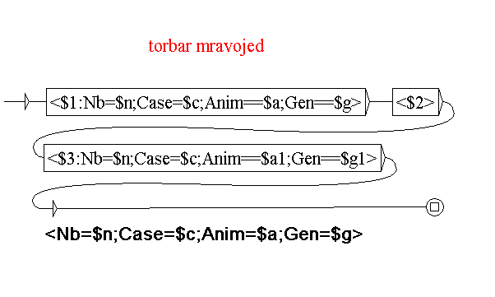
A correct and effective solution that uses a special transducers for inflection of compounds
torbar(torbar.N2:ms1v) mravojed(mravojed.N2:ms1v), NC_NXN+C+Zool

Slide 16
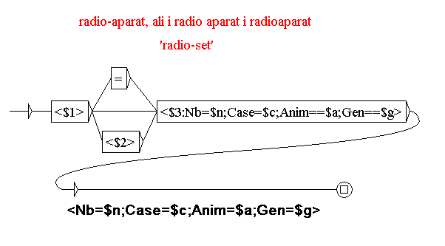
Description of orthographic variants – an optional hyphen that can be replaced by a space or an empty string

Slide 17
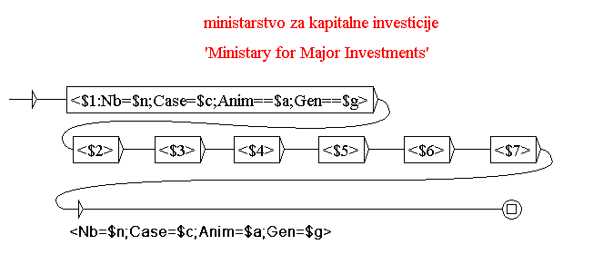
An arbitrary number of components in a compound

Slide 18
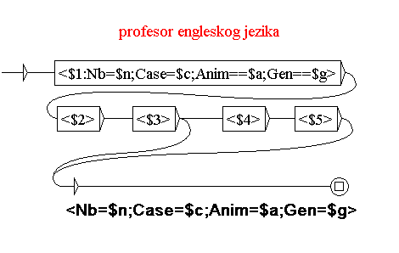
Omission of some components

Slide 19
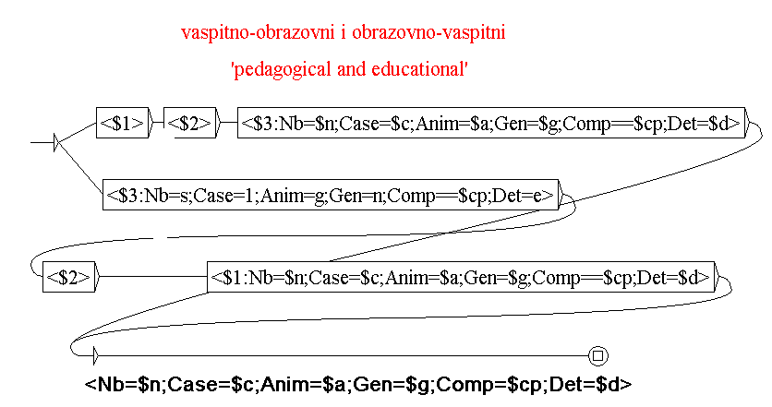
Different order of components

Slide 20
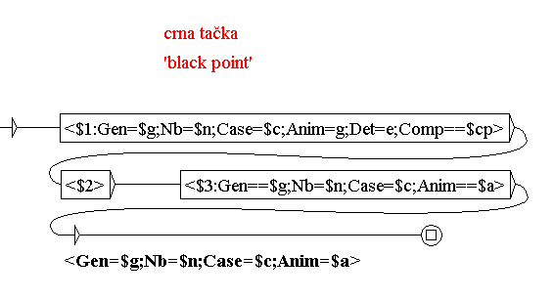
Fixed vs. inflective categories

Slide 21
Multiple paths in an inflectional graph
Examples from the corpus: Trinidad i Tobago
The number of a compound:
…do sada je i Trinidad i Tobago igrao ofanzivnije od nas…
Trinidad i Tobago su postali nezavisna država u okviru Britanskog Komonvelta...
Inflection, the genitive case:
Selektor Trinidada i Tobaga (je) srećan…
...meč B grupe između Engleske i Trinidad i Tobaga...
The instrumental case:
Bahrein će igrati sa Trinidadom i Tobagom u plej-ofu...
…fudbaler propustio je meč koji je Engleska igrala sa Trinidad i Tobagom
The locative case:
... već je poslednji put viđen u Trinidadu i Tobagu...
Otkako je grupa kupila železaru u Trinidad i Tobagu...
Notes:
Locative

Slide 22
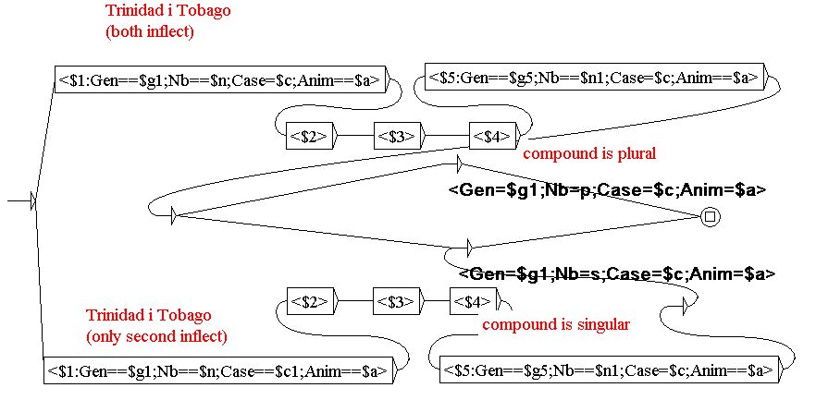
A inflectional transducer with multiple paths

Slide 23
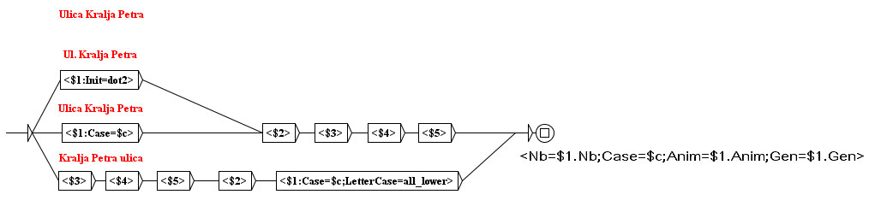
Modification of components
Some produced entries (for the instrumental case)
  Ulicom Kralja Petra,Ulica Kralja Petra.N:s6fq
  Ul\. Kralja Petra,Ulica Kralja Petra.N:s6fq
  Kralja Petra ulicom,Ulica Kralja Petra.N:s6fq

Slide 24
A complex example
Ujedinjenje nacije – United Nations
  Inflects as a compound AXN3 (does not inflect in number)
  Produces an acronym UN
    It can inflect; it is in masculine gender, singular
    It may not inflect;
      masculine singular
      feminine singular
      feminine plural

Slide 25
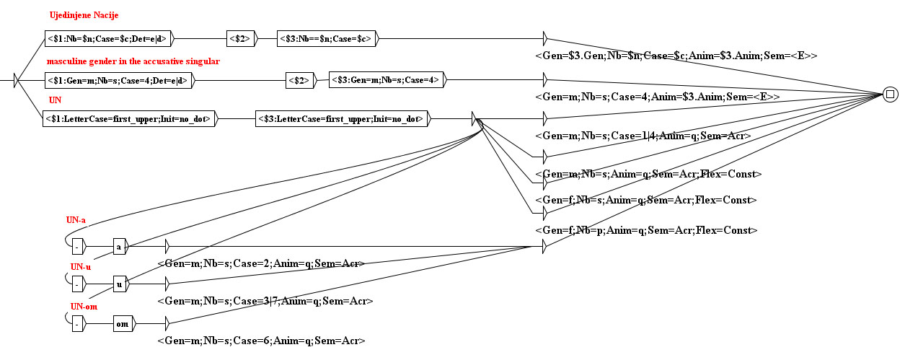
A complex example

Slide 26
Some produced entries
Ujedinjenim nacijama,Ujedinjene nacije.N:p7fq
Ujedinjenima nacijama,Ujedinjene nacije.N:p7fq
UN,Ujedinjene nacije.N:s1mqA
UN,Ujedinjene nacije.N:s4mqA
UN,Ujedinjene nacije.N:sfqAC
UN,Ujedinjene nacije.N:pfqAC
UN-a,Ujedinjene nacije.N:s2mqA
UN-u,Ujedinjene nacije.N:s3mqA
UN-u,Ujedinjene nacije.N:s7mqA
UN-om,Ujedinjene nacije.N:s6mqA
UN,Ujedinjene nacije.N:smqAC

Slide 27
Outline
About compounds
Collecting compounds
Inflection of compounds
Production of lemmas
More information

Slide 28
Some lemmas from the Serbian dictionary of compounds DELAC
digitalni(digitalni.A2:adms1g) video disk(disk.N297:ms1q),NC_A3XN+Conc
rab(rab.N1002:ms1v) Božiji(Božiji.A3:adms1g),NC_NXA3+Hum
lekar(lekar.N2:ms1v) akušer(akušer.N2:ms1v),NC_NXN+Hum
Banja(Banja.N600:fs1q) Vrujica(Vrujica.N623:fs1q),NC_NXN2+NProp
Mirosinka(Mirosinka.N1637:fs1v) Dinkić(Dinkić.N1028:ms1v),NC_NXN3+Hum
gladan(gladan.A18:akms1g) kao vuk(vuk.N128:ms1v),AC_A3XN2
glupa(glup.A15:aefs1g) kao guska(guska.N603:fs1v),AC_A3XN1

Slide 29
How to produce such complex lemmas
For Serbian, we produce them automatically (only the result has to be checked)
We produced a special software tool – LeXimir – that among other tasks automatically produces DELAC lemmas from a list of compounds (with addition of semantic markers) provided by a user
When DELAC lemmas and inflectional transducers for compounds are prepared, Unitex automatically produces DELACF dictionary of compound forms.

Slide 30
One list prepared for processing
žut kao šafran +Col
usoljeni limun +Conc+Food+Prod+DOM=Culinary
basamati pirinač +Conc+Food+Prod+DOM=Culinary
đanduja čokolada +Conc+Food+Prod+DOM=Culinary
hleb s krompirom +Conc+Food+Prod+DOM=Culinary
hleb sa krompirom +Conc+Food+Prod+DOM=Culinary
paradajz u ulju +Conc+Food+Prod+DOM=Culinary
soja sos +Conc+Food+Prod+DOM=Culinary
vuster sos +Conc+Food+Prod+DOM=Culinary
ben-mari +WoS+DOM=Culinary
crni susam +Conc+Prod+Food+DOM=Culinary
arborio pirinač +Conc+Prod+Food+DOM=Culinary
hlebno testo +Conc+Prod+Food+DOM=Culinary+Ek
hljebno testo +Conc+Prod+Food+DOM=Culinary+Ijk

Slide 31
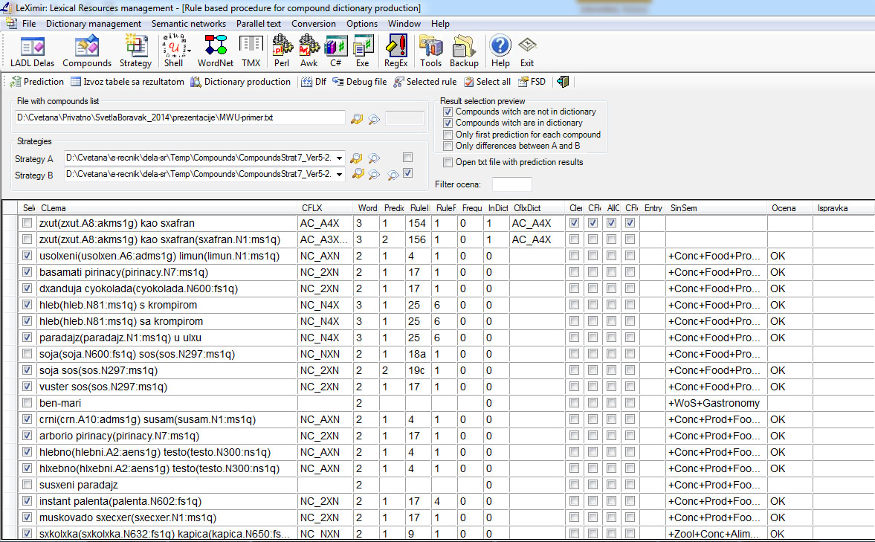
Check and selection of a correct lemma

Slide 32
Produced dictionary
usoljeni(usoljen.A6:adms1g) limun(limun.N1:ms1q),NC_AXN+Conc+Food+Prod
basamati pirinač(pirinač.N7:ms1q),NC_2XN+Conc+Food+Prod+DOM=Culinary
đanduja čokolada(čokolada.N600:fs1q),NC_2XN+Conc+Food+Prod+DOM=Culi
hleb(hleb.N81:ms1q) s krompirom,NC_N4X+Conc+Food+Prod+DOM=Culinary
hleb(hleb.N81:ms1q) sa krompirom,NC_N4X+Conc+Food+Prod+DOM=Culinary
paradajz(paradajz.N1:ms1q) u ulju,NC_N4X+Conc+Food+Prod+ DOM=Culinary
soja sos(sos.N297:ms1q),NC_2XN+Conc+Food+Prod+ DOM=Culinary
vuster sos(sos.N297:ms1q),NC_2XN+Conc+Food+Prod+ DOM=Culinary
crni(crn.A10:adms1g) susam(susam.N1:ms1q),NC_AXN+Conc+Prod+Food+DO
arborio pirinač(pirinač.N7:ms1q),NC_2XN+Conc+Prod+Food+ DOM=Culinary
hlebno(hlebni.A2:aens1g) testo(testo.N300:ns1q),NC_AXN+Conc+Prod+Food+D
hljebno(hljebni.A2:aens1g) testo(testo.N300:ns1q),NC_AXN+Conc+Prod+Food+

Slide 33
Some entries from DELACF dictionary automatically produced
digitalnim video diskom,digitalni video disk.N:ms6q
digitalni video diskovi,digitalni video disk.N:mp1q
digitalnih video diskova,digitalni video disk.N:mp2q
digitalnim video diskovima,digitalni video disk.N:mp3q
digitalne video diskove,digitalni video disk.N:mp4q
digitalni video diskovi,digitalni video disk.N:mp5q
digitalnim video diskovima,digitalni video disk.N:mp6q
digitalnim video diskovima,digitalni video disk.N:mp7q
digitalna video diska,digitalni video disk.N:mw2q
digitalna video diska,digitalni video disk.N:mw4q
digitalni video disk,digitalni video disk.N:ms1q
digitalnoga video diska,digitalni video disk.N:ms2q
digitalnog video diska,digitalni video disk.N:ms2q
digitalnomu video disku,digitalni video disk.N:ms3q
digitalnome video disku,digitalni video disk.N:ms3q

Slide 34
Outline
About compounds
Collecting compounds
Inflection of compounds
Production of lemmas
More information

Slide 35
Projects, conferences,...
Parseme - (PARSing and Multi-word Expressions)
  Towards linguistic precision and computational efficiency in natural language processing
  http://typo.uni-konstanz.de/parseme/
MWE Workshops at major conferences
SIGLEX-MWE Web site
  http://multiword.sourceforge.net/PHITE.php?sitesig=MWE

Slide 36
Thank you
Contact
Cvetana Krstev
cvetana@matf.bg.ac.rs
http://poincare.matf.bg.ac.rs/~cvetana/

