Slide 1
Dictionary priorities, e-dictionaries of compounds, morphological mode
Cvetana Krstev & Duško Vitas

Slide 2
The morphological mode
When working with a text that Unitex has already tokenized, then the only way to pose a query that searches inside a token is to use morphological filters (from what we learned by now).
But morphological filters have their limits because they cannot refer to dictionaries.
They cannot be used to pose a following query: a token formed by a string which is a legal prefix and a string which is a legal verb form.
What would be a result of a search with this graph?
Nothing! Because it looks for a prefix which is a token and a token that is a verb form – that is two separate tokens.

Slide 3
How to use the morphological mode?
A part of a grammar that we intend to apply in Locate pattern which should be used in the morphological mode should be enclosed with special boxes $< and $>.
These boxes will appear in a graph like violet angular brackets.
In this mode matching is performed letter by letter, and not token by token.
What would be result of a search with this graph?
Again nothing! Because graphs should abide to special rules when they enter the morphological mode.

Slide 4
Rules of the morphological mode(1)
The implicit space does not exist between boxes (as outside the morphological mode). If a space should be matched in the morphological mode, then it should be explicitly written ″ ″.
Sub-graphs can be used, but the beginning and the end of the morphological mode have to be in the same graph.
Variables cannot be introduced in the morphological mode with $x( and $x).
Lexical patterns that refer to dictionaries can be used (like <V:G:T>), as well as morphological filters on <DIC>.
Left and right contexts are prohibited.
Transducer outputs can be used.
Morphological filters can apply to <TOKEN> but they will actually apply only to one character (which is “token” in this case), like in <TOKEN><<[^aeiou]>>.

Slide 5
Rules of the morphological mode(2)
<MOT> matches any letter (as defined in Alphabet).
<MIN> matches any lower-case letter (as defined in Alphabet).
<MAJ> matches any upper-case letter (as defined in Alphabet).
<DIC> matches any word present in a morphological dictionary.
Lexical patterns referring to morphological dictionaries can be used.
Patterns #, <PRE>, <NB>, <TOKEN>, <SDIC> and <CDIC> are forbidden.
If a program Locate reaches the end of the morphological zone (a box $>) before reaching the end of a token, the match will fail. For instance, the previous graph can not match(pre)(vodi) in prevodilac although it matches a prefix followed by a verb form.

Slide 6
What are morphological dictionaries and how to use them?
In the morphological mode it is possible to use queries that refer to dictionaries, in order to recognize, for instance (pot)(krpili).
The verb form krpiti – krpili – (from krpiti ) need not be in a text itself, and so the dictionary of a text cannot be used.
Because of that a user should prepare a list of dictionaries that he/she wishes to use in the morphological mode.
These dictionaries may be chosen from those normally used but can also be specific for recognitions inside tokens (like dictionaries of affixes).

Slide 7
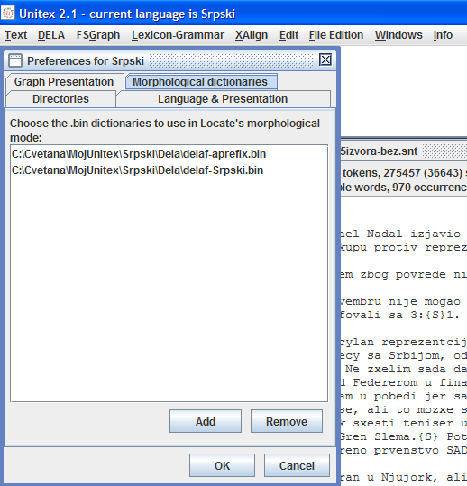
Defining a list of morphological dicitonaries
Use the option Preferences menu Info, a card Morphological dictionaries.
Dictionaries – only in .bin format are added by pressing Add, and removing from a list by pressing Remove.
For Serbian a dictionary of prefixes is selected delaf-aprefix.bin that is not used for normal processing, and
a general dictionary delaf-Srpki.bin used for normal processing.

Slide 8
Results of searching with a graph in the morphological mode
When applied to a collection 5izvora following verb forms obtained by prefixation from existing verbs (with a LOT of noise).
What does a form pobede do here? A prefix po and a form of verb bediti, bede.
If we add the following negative context – outside the morphological mode – graph will extract forms that are maybe verbs obtained by prefixation.
What does protivnica do here? A prefix protiv and a verb nicati, a form nica (aorist 3rd person singualar).

Slide 9
Dictionary entry variables
User can associate variables with patterns that refer to morphological dictionaries (except <DIC>).
The output of such a box is the associated variable $x$.
$x.LEMMA$ - a lemma of a recognized form
$x.INFLECTED$ - a recognized form
$x.CODE$ - codes associated to a lema
We get the following decomposition if we use this graph in the MERGE mode.

Slide 10
Additional dictionary entry variables
The CODE variable can be used with three additions:
$x.CODE.GRAM$ returns the first grammatical code, usually that is a PoS code.
$x.CODE.SEM$ returns remaining grammatical codes, separated with plus sign +; usually semantic markers.
$x.CODE.FLEX$ returns all inflectional codes separated with a colon :.
We get the new decomposition if we use this graph in the MERGE mode.

Slide 11
Dictionary graphs that use the morphological mode
The morphological mode, together with dictionary entry variables can be used in dictionary graphs.
This is one such graph – it recognizes adverbs that were constructed by prefixation from adverbs already in a dictionary.
A “prefix” ca be a “true” prefix (from a morphological dictionary of prefixes) or an adjective form in the neuter singular form.
Such a dictionary graph should be applied with the lowest priority (+).
In the collection 5-izvora following “new” adverbs. are recognized.

Slide 12
Output variables
Normal variables, introduced by boxes $xxx( and $xxx) capture a part of a input text – a part that matched a part of a grammar.
Output variables captures a part of an output produced by a grammar.
They are introduced by $|xxx( and $|xxx).
They appear as blue parenthesis in a graph.
Important! They do not actually produce the output – the output is stored as a value of corresponding output variable.
Important! If output is a variable, like $a.LEMMA$, then this string will not be the value of corresponding output variable; its value will be a lemma corresponding to the input string stored in $a$.

Slide 13
An example of the use of output variables
The value of the output variable is the type of recognized input strings.
When applied to the text 5izvora-izvod in MERGE mode, following concordance lines are obtained.
Note! No output is produced around recognized input strings.

Slide 14
Operations on variables
Two types of operation on variables are possible:
testing variables
comparing variables
Both operations on variables apply to all kind of variables: normal, output and dictionary.

Slide 15
Testing variables
It is possible to test whether a variable is set or not in order to block a current matching operation if a condition is not satisfied.
In order to test whether a variable is set enter an empty box with the output set to $xxx.SET$. This output will be ignored, and if the variable xxx has been defined, the matching operation will continue, otherwise it will fail.
The reverse test is $xxx.UNSET$

Slide 16
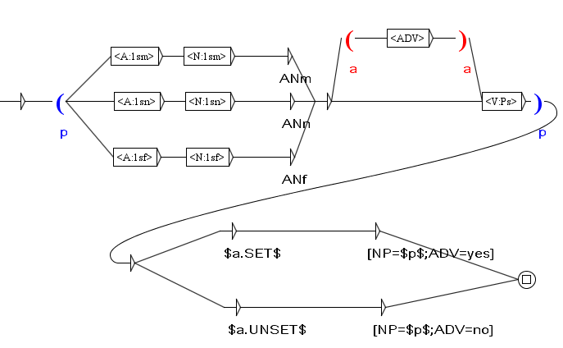
An example with testing variables
Between a noun phrase and a verb there can be an adverb. This graph produces different output consequently.
When applied to the text 5izvora-izvod in MERGE mode, following concordance lines are obtained.

Slide 17
Comparing variables
This is another kind of a test.
User can compare a value of a variable against another variable or a constant value.
Use $xxx.EQUAL=yyy$ as the output of an empty box to test whether variables xxx and yyy have the same value. If the test fails, the grammar will block.
Use $xxx.EQUAL=#yyy$ as the output of an empty box to test whether variables xxx has the value yyy. If the test fails, the grammar will block.
The reverse test is $xxx.UNEQUAL=yyy$

Slide 18
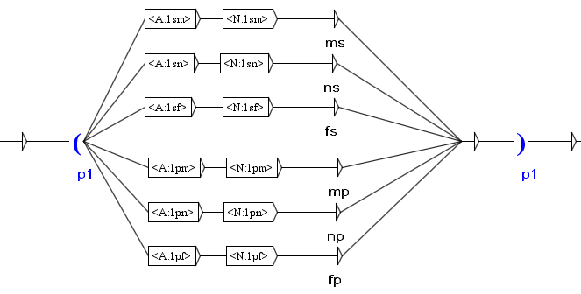
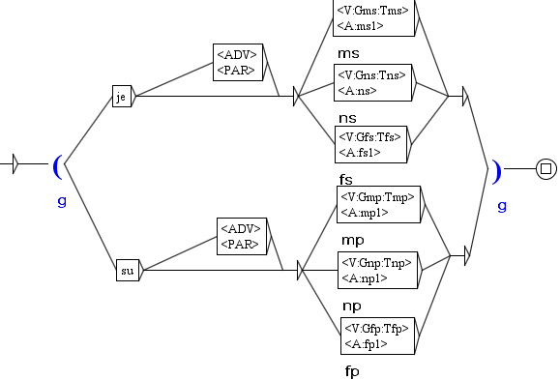
An example with comparing variables (1)
The first graph recognizes an adjective/noun construction and produces an output important for agreement.
More such graphs exist: demonstrative pronoun/noun, possessive pronoun/noun, etc.
The second graph recognizes a simple verb phrase: Aux/Adjective, past perfect, present passive. This verb phrase agrees with gender and number.

Slide 19
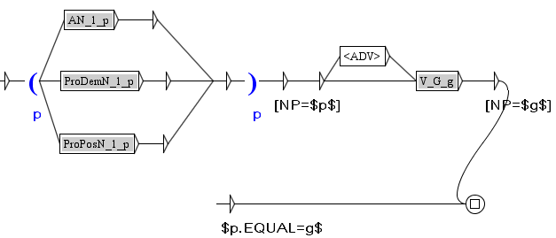
An example with comparing variables (2)
This graph recognizes a simple phrases: NP [ADV] VP
When applied to the text 5izvora-izvod in MERGE mode, following concordance lines are obtained if output agreement variables of noun and verb phrases are NOT tested.
If output agreement variables of noun and verb phrases ARE tested, then retrieval produces different results.

