Slide 1
Local Grammars – 2nd part
Cvetana Krstev
University of Belgrade
Faculty of Philology

Slide 2
Outline
An example of a local grammar
Transducers
(Input) variables
The use of contexts
A complete example
Morphological mode
Output variables

Slide 3
What does a sub-graph MereTacno recognize?
It recognizes numerals (written in various possible ways)
With digits, words, combinations, special symbols (⅓)
a noun with the semantic marker +Mes (a measurement unit)

Slide 4
One of two sub-graphs
Recognizes:
A multi-word numeral (+Comp)
Followed by a measurement unit in the corresponding case and number (+v1, +v2, +v5)

Slide 5
What does the graph MereTacno recognize?
Recognitions in a collection of newspaper texts from Politika (~1M tokens).
The sub-graph recognized 986 sequences of numerals followed by a measurement unit. Measurements
There were some minor deficiencies in recognition, e.g. Ubrzanje 0-100 km/h
Ranges are not recognized
That is why MereTacno is just a subgraph!

Slide 6
Outline
An example of a local grammar
Transducers
(Input) variables
The use of contexts
A complete example
Morphological mode
Output variables

Slide 7
Transducers
A difference between graphs and transducers is that graphs recognize something while transducers can also modify the analyzed text.
The output is written below a box; the successful recognition of that box produces the output.
<E>/<MERA>, <E> is the box content, and <MERA> is the output.
The output is separated from the box content by a slash.

Slide 8
An example of a transducer
The XML tags <MERA> and </MERA> are inserted before and after a successfully recognized sequence “numeral/measurement unit”.
It is important to note that although the first output, the XML start-tag <MERA> is written bellow the empty box at the very beginning of the graph, no output will be produced unless there is a successful recognition, that is the final state is reached.

Slide 9
How are transducers applied?
How transducers work? They can work as simple graphs, that is the output is ignored.
If output is to be produced then transducers work in the merge mode (output is merged with the inuput text) or in the replace mode (output replaces the recognied text)
To insert XML tags transducers works in the merge mode
Two other possibilities:
User can produced concordances, as before, only in concordances the produced output will appear: XML concordances for measurements
User can produce a new version of a text with output inserted (or with recognized sequences replaced by the output).

Slide 10
How does a new text looks like?
Although the option is called Modify text, the original text is not modified; instead, the new file with inserted output is produced.
How does new text looks like in the case of our input text? – XML tags for measurements
This new text can be read by Unitex, dictionaries can be applied and it can be processed and modified by other graphs and transducers.

Slide 11
Outline
An example of a local grammar
Transducers
(Input) variables
The use of contexts
A complete example
Morphological mode
Output variables

Slide 12
Use of variables in graphs
Unitex enables use of variables that memorize a part of a recognized sequence.
A memorized part can be used in a transducer’s output.
To assign to a variable var a part of a recognized sequence it should be enclosed in special boxes $var( and $var).
This boxes should not contain anything else but $var( or $var).
For variable names one can use upper-case and lower-case letters, digits and an underscore. Unitex variables are case-sensitive!

Slide 13
What does this transducer do?
It recognizes a numeral (written in any possible way) followed by a string dolar or dolara.
A recognized numeral is memorized as a value of a variable var.
The output is produced in the form VREDNOST=a_recognized_numeral + a_dolar_sign, and all that is embraced in brackets.
An important note: A variable cannot be used in advance. For instance, it cannot be used to produce a value of an attribute of XML tag <IZNOS>.
Some concordances produced in the merge mode for our input text produce: dolari

Slide 14
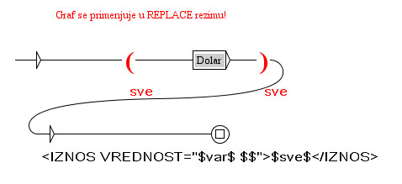
Can a XML attribute be produced anyway?
Yes!
Use two variables: one for the attribute value, as before, and the second for the whole recognized string.
Apply a transducer in the replace mode.
All variables are global, and their values can be transferred from a sub-graph to a graph that invokes it, as shown by the example.

Slide 15
What does the previous transducer recognize and tag?
It is important to apply a transducer in the mode Replace recognized sequences – the old recognized sequence will be replaced by the same sequence embedded in XML tags.
How does a new text look like? XML tags for dollars

Slide 16
One more example that uses variables
A graph recognizes a date written with digits in other uniform format – a year, a month, a day separated by a slash.
Three sub-graphs are invoked: each of them recognizes a sequence of digits that can represent a day in a month, a month in a year, and a year.

Slide 17
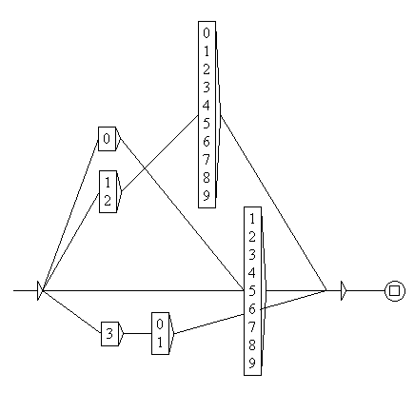
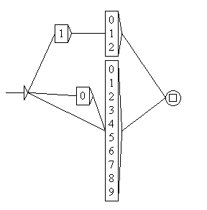
Sub-graphs of a Date transducer
A sub-graph that recognizes a day in a month (2cifra)
A sub-graph that recognizes a month in a year (2cifra-mesec)
Application of a transducer on the collection 5izvora A date

Slide 18
Outline
An example of a local grammar
Transducers
(Input) variables
The use of contexts
A complete example
Morphological mode
Output variables

Slide 19
The use of contexts in Unitex graphs
Graphs described so far correspond to so-called algebraic grammars, known also as context-free grammars.
A context-free grammar X recognizes a sequence A regardless of a context in which it occurs.
With such grammars it is not possible to recognize all occurrences of <predsednik.N> if they are not followed by republike.
Unitex graphs can use positive and negative contexts.
These graph do not correspond anymore to context-free grammars but rather to context-sensitive grammars.

Slide 20
The right context
In order to define a right context it should be enclosed with boxes that contain $[ and $].
These boxes will appear in a graph as big green brackets.
Both brackets have to be in the same graph.
This simple graph recognizes persons (surnames) only if they are followed by an auxilary verb in the corresponding form – verbs are not part of a recognized sequence.
In Politika this graph recognizes persons.

Slide 21
How are positive right contexts interpreted?
The application of a grammar has reached a right context start ([).
The position in a text in that moment is pos.
A program Locate tries to match the expression inside the brackets (that defines a context) with a text at that position.
If program does not succeed, there can be no match of a grammar.
If there is a match with the whole right context (the Locate program managed to reach a right bracket), than Locate returns to the position pos and continues to apply a grammar, that is, its part after the end of a right context.

Slide 22
A negative right context
A negative right context can be introduced with a box $![ a a start of a context.
A following graph recognizes a lexeme predsednik, if it is not followed by vlade, republike or države (and some country or personal name).
In our text following occurrences of presidents (not of government, republic or state). Concordances are sorted by a right context.

Slide 23
How are negative right contexts interpreted?
Program Locate tries to match a part of a grammar that represents a context with a text at the positionpos.
If the program Locate reaches the end of a context (a right bracket) it is a failure because of a match with the forbidden sequence.
On a contrary, if the program Locate cannot reach the end of a context, it will go back to the position pos and continues to apply a grammar, that is, its part after the end of a right context.

Slide 24
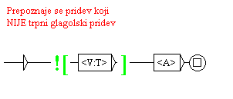
A right context at the beginning of a graph
A right context can appear anywhere in a graph, including its beginning.
Following graph recognizes an adjective that is in the right context of something that is not a past participle.
In other words, adjectives are recognized if they are not ambiguous with verbal past participles.
(a Locate program tries to match a context; if it fails, a current position in a text is not a past participle; at the same position a Locate program tries to mach an adjective; if there is a match, a grammar succeeds).
In one novel (Voltaire’s Candide) adjectives (not past participles) are recognized (different from all adjectives <A> - rejected adjectives).

Slide 25
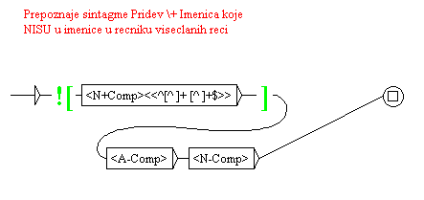
A complex right context
This graph recognizes in a text all adjectives (that are not compounds – a mark ~Comp) followed by nouns (that are not compounds – a mark ~Comp) but only if the combination is not ambiguous with a compound already in a dictionary.
A compound is defined as a noun (that is a compound – a mark +Comp) having only two components. This is defined with a morphological filter:
at the beginning
something that does not contain a space
a space
something that contains a space
the end
In one novel chapter
adjective/noun not in CDIC
(different from all
<A~Comp> <N~Comp>).

Slide 26
A left context
A left context enables matching an expressions X in a text only if occurs after an occurrence of an expressions Y.
It could be achieved with syntactic grammars (local grammars) that we used so far, but with them an expressions Y is a part of a match.
In order to avoid this user can use a box $* (that is seen in a graph as a green star) to point at the end of a left context.
The achieved effect is that that part of a grammar is used for matching, but is ignored in results.

Slide 27
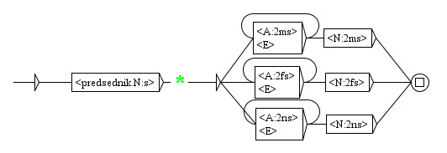
An example of a grammar that uses a left context
This graph recognizes a noun phrase in the genitive case singular if preceded by a noun predsednik
Concordances produced on Politika for president of something.

Slide 28
The use of both left and a right context in the same graph
With left and right contexts a difference is made between a pattern that matches something and what we want to extract from a text.
A graph recognizes the auxiliary jesam or hteti, followed by an adverb, followed by a present or a past participle or infinitive.
The following adverbs preceded by the auxiliary jesam or hteti, and followed by the participle or the infinitive are extracted from Candide.

Slide 29
Outline
An example of a local grammar
Transducers
(Input) variables
The use of contexts
A complete example
Morphological mode
Output variables

Slide 30
The use of contexts – a larger example
A task: recognition and tagging of hydronyms (water bodies) in Serbian newspaper texts.
Hydronyms in Serbian e-dictionary:
Dunav,N1001+NProp+Top+Hyd
Problems: hydronyms are ambiguous with:
other geographic names: Bosna – a river and a region.
personal names: Una – a river and a feminine name, Sava – a river and a masculine name
Common nouns

Slide 31
The first solution
We use as a text a small collection of news dealing with recent floods in Serbia Poplave (~10.000 simple words)
What do we locate in a text with a pattern:
<N+NProp+Top+Hyd>
All names of water bodies (recorded in e-dictionaries) but also a number of false recognitions (Oko, Po...).
89 matches

Slide 32
The first improvement
We take into consideration only hydronym names that are not ambiguous with other proper or common names – use of a negative right context.
This graph retrieves some names of water bodies but also rejects some correct recognitions.
40 matches in a collection Poplave
differences from a previous recognition

Slide 33
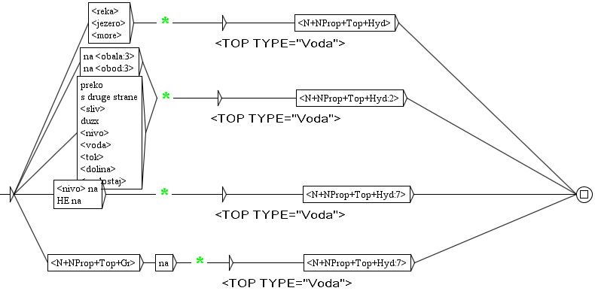
The second improvement
We try to retrieve some of falsely rejected matches.
This graph matches names of water bodies if they have a “right” left context.
54 matches in a collection Poplave
differences from a previous recognition

Slide 34
The third improvement
We try to retrieve some more of falsely rejected matches.
This graph matches names of water bodies if they have a “right” right context.
61 matches in a collection Poplave
differences from a previous recognition
Example: Sava je poplavila vikend naselje...

Slide 35
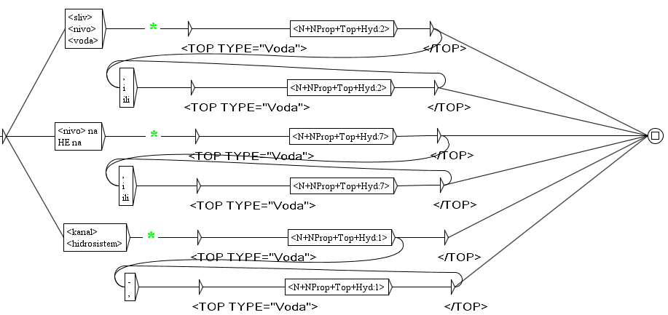
The forth improvement
We try to retrieve some more of falsely rejected matches.
This graph matches names of water bodies if they appear in a sort of a list of water body names with the ”right” left context.
59 matches in a collection Poplave
differences from a previous recognition
Example: Kolubara

Slide 36
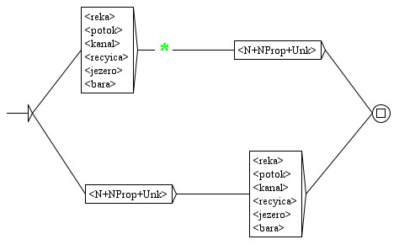
The fifth improvement
We try to retrieve some more entries – even those that are not in dictionaries but with an obligatory key word following or preceding
76 matches in a collection Poplave
differences from a previous recognition
Example: Tulovska reka, (reka) Lugomir

Slide 37
Outline
An example of a local grammar
Transducers
(Input) variables
The use of contexts
A complete example
Morphological mode
Output variables

Slide 38
The morphological mode
When working with a text that Unitex has already tokenized, then the only way to pose a query that searches inside a token is to use morphological filters (from what we learned by now).
But morphological filters have their limits because they cannot refer to dictionaries.
They cannot be used to pose a following query: a token formed by a string which is a legal prefix and a string which is a legal verb form.
What would be a result of a search with this graph?
Nothing! Because it looks for a prefix which is a token and a token that is a verb form – that is two separate tokens.

Slide 39
How to use the morphological mode?
A part of a grammar that we intend to apply in Locate pattern which should be used in the morphological mode should be enclosed with special boxes $< and $>.
These boxes will appear in a graph like violet angular brackets.
In this mode matching is performed letter by letter, and not token by token.
What would be result of a search with this graph?
Again nothing! Because graphs should abide to special rules when they enter the morphological mode.

Slide 40
Rules of the morphological mode(1)
The implicit space does not exist between boxes (as outside the morphological mode). If a space should be matched in the morphological mode, then it should be explicitly written ″ ″.
Sub-graphs can be used, but the beginning and the end of the morphological mode have to be in the same graph.
Variables cannot be introduced in the morphological mode with $x( and $x).
Lexical patterns that refer to dictionaries can be used (like <V:G:T>), as well as morphological filters on <DIC>.
Left and right contexts are prohibited.
Transducer outputs can be used.
Morphological filters can apply to <TOKEN> but they will actually apply only to one character (which is “token” in this case), like in <TOKEN><<[^aeiou]>>.

Slide 41
Rules of the morphological mode(2)
<MOT> matches any letter (as defined in Alphabet).
<MIN> matches any lower-case letter (as defined in Alphabet).
<MAJ> matches any upper-case letter (as defined in Alphabet).
<DIC> matches any word present in a morphological dictionary.
Lexical patterns referring to morphological dictionaries can be used.
Patterns #, <PRE>, <NB>, <TOKEN>, <SDIC> and <CDIC> are forbidden.
If a program Locate reaches the end of the morphological zone (a box $>) before reaching the end of a token, the match will fail. For instance, the previous graph can not match(pre)(vodi) in prevodilac although it matches a prefix followed by a verb form.

Slide 42
What are morphological dictionaries and how to use them?
In the morphological mode it is possible to use queries that refer to dictionaries, in order to recognize, for instance (pot)(krpili).
The verb form krpiti – krpili – (from krpiti ) need not be in a text itself, and so the dictionary of a text cannot be used.
Because of that a user should prepare a list of dictionaries that he/she wishes to use in the morphological mode.
These dictionaries may be chosen from those normally used but can also be specific for recognitions inside tokens (like dictionaries of affixes).

Slide 43
Results of searching with a graph in the morphological mode
This graph would return a LOT of noise
If we add the following negative context – outside the morphological mode – graph will extract forms that are maybe verbs obtained by prefixation.
What does povrda (a typo) do here? A prefix po and a verb vrdati, a form vrda (present and aorist 3rd person singular).

Slide 44
Dictionary entry variables
User can associate variables with patterns that refer to morphological dictionaries (except <DIC>).
The output of such a box is the associated variable $x$.
$x.LEMMA$ - a lemma of a recognized form
$x.INFLECTED$ - a recognized form
$x.CODE$ - codes associated to a lema
We get the following decomposition if we use this graph in the MERGE mode.

Slide 45
Additional dictionary entry variables
The CODE variable can be used with three additions:
$x.CODE.GRAM$ returns the first grammatical code, usually that is a PoS code.
$x.CODE.SEM$ returns remaining grammatical codes, separated with plus sign +; usually semantic markers.
$x.CODE.FLEX$ returns all inflectional codes separated with a colon :.
$xxx.CODE.ATTR=yyy$: provides the value of an attribute-value pair contained in the semantic codes, i.e. the value zzz of the yyy attribute if there is a code of the form yyy=zzz.
For instance, if Šekspir was recognized in a text and put in a variable $ime$, and a dictionary entry was:
Šekspr,N1002+NProp+Hum+Last+Cel+DOM=Lit+Val=Shakespear
Than the value of dictionary variable $ime.CODE.ATTR=Val$ would be Shakespeare

Slide 46
Dictionary graphs that use the morphological mode
The morphological mode, together with dictionary entry variables can be used in dictionary graphs.
This is one such graph – it recognizes adverbs that were constructed by prefixation from adverbs already in a dictionary.
A “prefix” can be a “true” prefix (from a morphological dictionary of prefixes) or an adjective form in the neuter singular form.
Such a dictionary graph should be applied with the lowest priority (+).
In the collection Politika following “new” adverbs. are recognized.

Slide 47
A more complex example
Derivational patterns around names of some well-known people
Patterns used for one name – Tito – already in dictionaries:
titovski
posttitovski
titoistički
titoizam
neotitoizam
titovka
titovati
How can all such occurences be extracted from a corpus for all names in dictionaries?

Slide 48
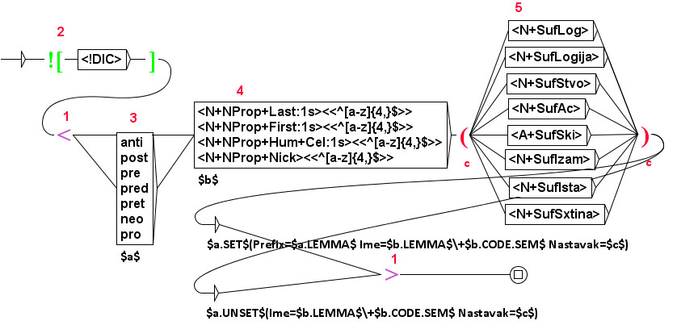
How can we do that using the morphological mode?
We are looking for all forms (not already in dictionaries) that are composed of
An optional prefix
Some personal name
A certain suffix

Slide 49
How can that work?
We have to produce a „special“ dictionary of sufixes with inflectional endings:
DELAC:
stvo,N330+Dummy+SufStvo
DELAF
stvo,stvo.N+Dummy+SufStvo:ns5q
stva,stvo.N+Dummy+SufStvo:nw2q
stva,stvo.N+Dummy+SufStvo:ns2q
stvu,stvo.N+Dummy+SufStvo:ns7q
stvu,stvo.N+Dummy+SufStvo:ns3q

Slide 50
What else?
Personal names in dictionaries have to be transformed in the lowercase form:
Instead
Gandi,Gandi.N+NProp+Hum+Cel:ms1v
We use
gandi,gandi.N+NProp+Hum+Cel:ms1v
On a large corpus (> 22 MW) we obtain candidates with and without prefixes

Slide 51
Outline
An example of a local grammar
Transducers
(Input) variables
The use of contexts
A complete example
Morphological mode
Output variables

Slide 52
Output variables
Normal variables, introduced by boxes $xxx( and $xxx) capture a part of a input text – a part that matched a part of a grammar.
Output variables captures a part of an output produced by a grammar.
They are introduced by $|xxx( and $|xxx).
They appear as blue parenthesis in a graph.
Important! They do not actually produce the output – the output is stored as a value of corresponding output variable.
Important! If output is a variable, like $a.LEMMA$, then this string will not be the value of corresponding output variable; its value will be a lemma corresponding to the input string stored in $a$.

Slide 53
An example of the use of output variables
The value of the output variable is the type of recognized input strings.
When applied to one text in MERGE mode, following concordance lines are obtained.
Note! No output is produced around recognized input strings.
But, what can it be used for?

Slide 54
Operations on variables
Two types of operation on variables are possible:
testing variables
comparing variables
Both operations on variables apply to all kind of variables: normal, output and dictionary.

Slide 55
Testing variables
It is possible to test whether a variable is set or not in order to block a current matching operation if a condition is not satisfied.
In order to test whether a variable is set enter an empty box with the output set to $xxx.SET$. This output will be ignored, and if the variable xxx has been defined, the matching operation will continue, otherwise it will fail.
The reverse test is $xxx.UNSET$

Slide 56
Comparing variables
This is another kind of a test.
User can compare a value of a variable against another variable or a constant value.
Use $xxx.EQUAL=yyy$ as the output of an empty box to test whether variables xxx and yyy have the same value. If the test fails, the grammar will block.
Use $xxx.EQUAL=#yyy$ as the output of an empty box to test whether variables xxx has the value yyy. If the test fails, the grammar will block.
The reverse test is $xxx.UNEQUAL=yyy$

Slide 57
One larger example
We have produced a collection of graphs that recognize constructions A_N and take care of the agreement
They allow special conditions to be forced both on adjectives and nouns in form of a left context
They output grammatical values of recognized A_N constructions
They can be used to recognize various constructions that have as a part a A_N constructions
Recognition of a verb in the infinitive followed by a A_N+Food in the accusative case (a construction often used in culinary recipes)

Slide 58
A main graph
It uses a subgraph (from a repositora of useful and reusable graphs)
A phrase A_N is accepted only if the output variable Pa has a value 4 (for the accusative case
This variable is set in the subgraph.

Slide 59
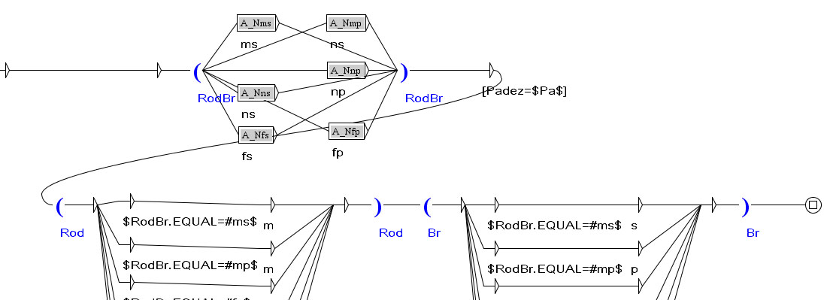
A subgraph A_N_glavni
It invokes six subgraphs for 6 cominations of various values of 3 genders and 2 numbers.
This values are output and become a value of an output variable RodBr (which is than split into variables Rod and Br)

Slide 60
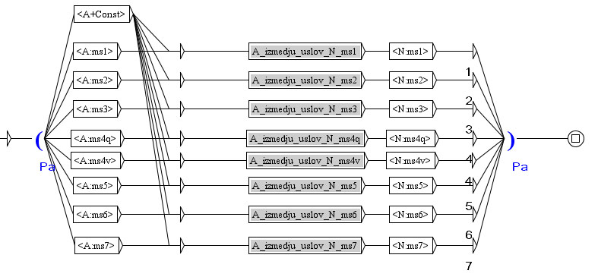
A subgraph
Each path corresponds to one case, and outputs a value of output variable Pa

Slide 61
A condition a noun has to satisfy
A condition is put in a separate subgraph so it can be easily replaced
A results obrained by this graph on a large corpus of (culinary) recipes (~1.5MW)

Slide 62
Thank you
Contact
Cvetana Krstev
cvetana@matf.bg.ac.rs
http://poincare.matf.bg.ac.rs/~cvetana/

