Slide 1
A few words about history
Duško Vitas
University of Belgrade
Faculty of Mathematics

Slide 2
Historical overview

Slide 3
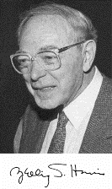
Zellig Harris
Far-away roots can be found in the transformational theory of Zellig S. Harris which requires complete formalization of the linguistic data: many variations of forms and numerous details neglected in most traditional approaches.
1909-1992

Slide 4
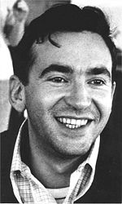
Maurice Gross
The follower of Zellig Harris, the French linguist Maurice Gross published in 1975. Méthodes en syntaxe that followed Harris’s basic requirements and constructed the lexicon-grammar for French.
1934-2001

Slide 5

Maurice Gross
Beginning in the 80s, LADL under leadership of Prof. Gross, developed morphosyntactic dictionaries (e-dictionaries) and local grammars for French (model based on FSA)
M. Gross, D. Perrin (Eds.) Electronic Dictionaries and Automata in Computational Linguistics, LNCS 377, 1989

Slide 6

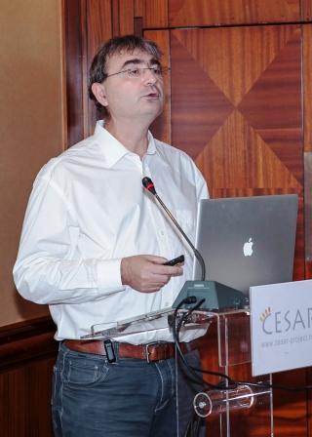
Intex
On the basis of resources developed in LADL, Max Silberztein in 90s developed a system Intex for their exploitation based on the theory of FSA and FST.

Slide 7
Intex
In the scope of the informal network RELEX that gathered a dozen of research teams e-dictionaries were developed for several languages (French, Italian, Spanish, Portuguese, English, German, Russian, Polish, Serbian, etc.).

Slide 8

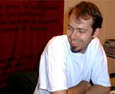
Unitex
Sebastian Paumier replaced Intex by the open-source (LGPL) system Unitex that works with Unicode and uses a lot of improved algorithms.

Slide 9
A few remarks on the applications of Unitex

Slide 10
Two types of applications
Since Unitex is an open-source system it has been incorporated in many software applications.
Unitex is used for linguistic and lexicographic research.

Slide 11
A software application

Slide 12
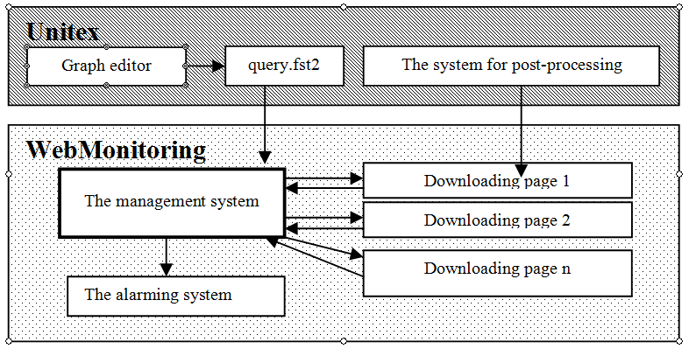
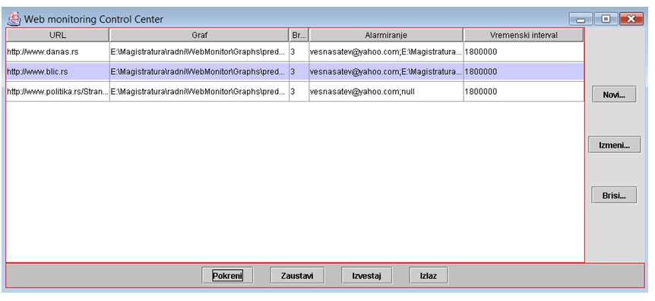
One example – web monitoring

Slide 13

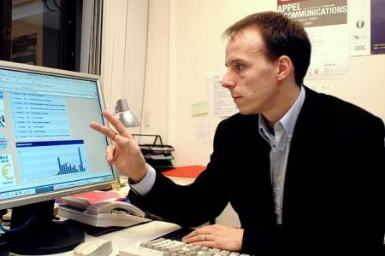
GlossaNet
GlossaNet is a specialized search engine and also watch engine. It lets you make searches in every published texts on the Internet in the form of RSS feeds : press, media, blogs, forum, firms, etc.
From a RSS publication list, you register a query and the system will analyse these sources and will search some keywords or expressions that you will have already specified. Then you could consult results on the GlossaNet interface or choose to receive reports by email.
Cédrick Fairon

Slide 14
Linguistic applications:
Example of exploitation of Aligned Corpora

Slide 15
Language applications
Exploitation of corpora for languages for which e-dictionaries were developed;
Refinement of a dictionary of a specific language;
Development of local grammars as a step in the formalization of a certain language.

Slide 16
Unitex and aligned texts
With Unitex you can handle electronic resources such as electronic dictionaries and grammars and apply them. You can work at the levels of morphology, the lexicon and syntax.
Unitex supports processing of bitexts aligned with XAlign.

Slide 17
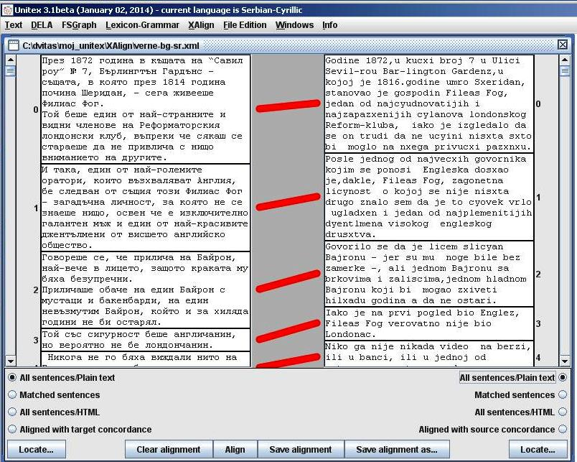
BG-SR example (Verne)

Slide 18
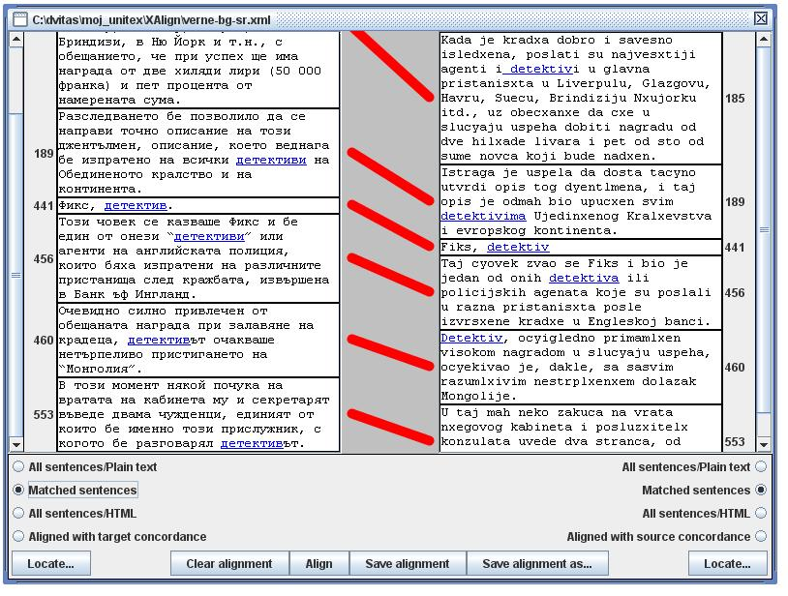
детектив (BG) = detektiv (SR)???

Slide 19
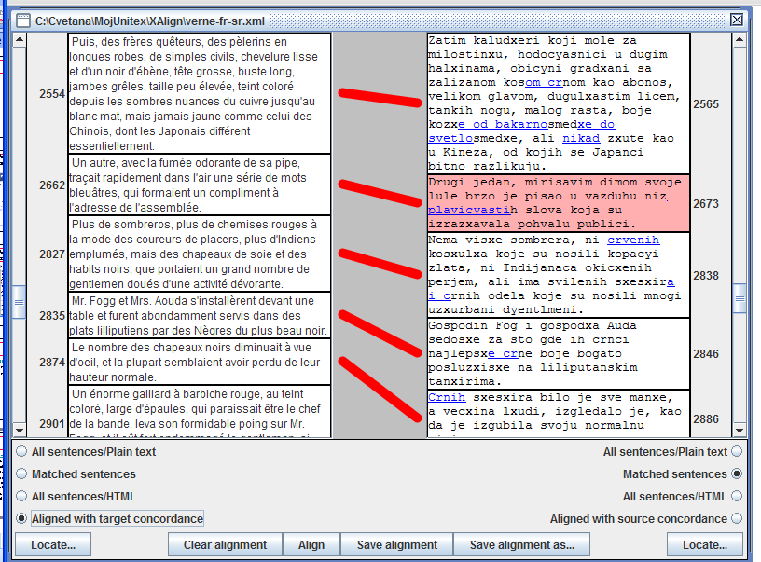
A simple query - colors
crn - noir
bakarnosmedj –
sombres nuances de cuivre
svetlosmedj – blanc mat
žut - jaune
<A+Col>

Slide 20
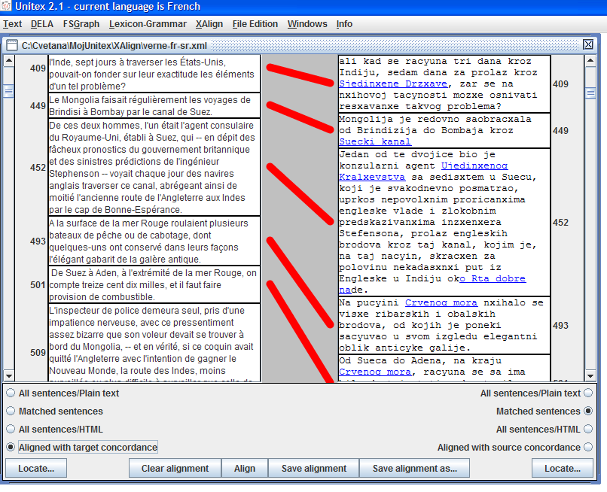
A more complex query –
MWU named entities
Suecki kanal –
canal de Suez
Ujedinjeno kraljevstvo –
Royaume-Uni
Rt dobre nade –
le cap de bon Espérance
<N+NProp+Comp>

Slide 21
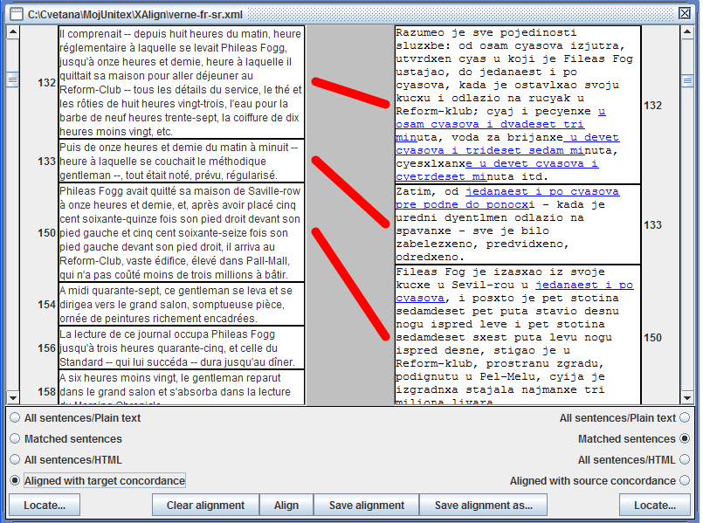
A complex query –
MWU named entities
u osam časova i dvadeset
tri minuta – de huit
heures vingt-trois
od jedanaest i po časova
prepodne do ponoći – de onze
heures et demi du matin
à minuit
TIMEX local grammar
for Serbian

Slide 22
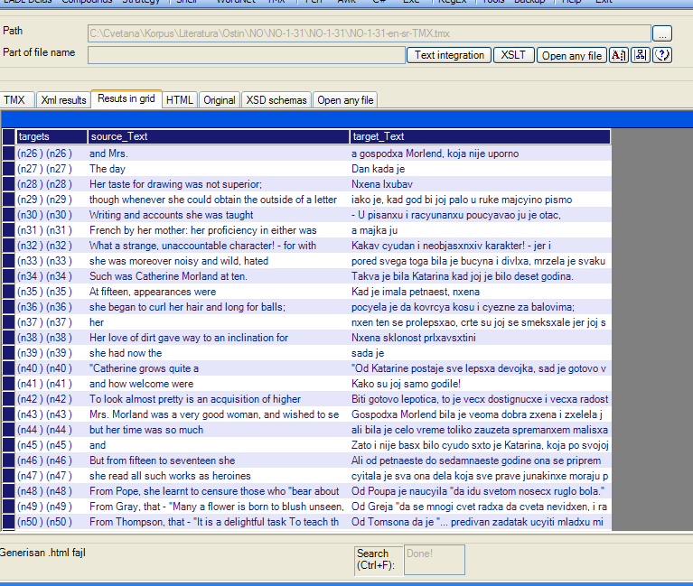
LeXimir – a versatile tool for maintaining and exploiting lexical and textual resources
TMX of Jane Austen’s novel
Northenger Abbey

Slide 23
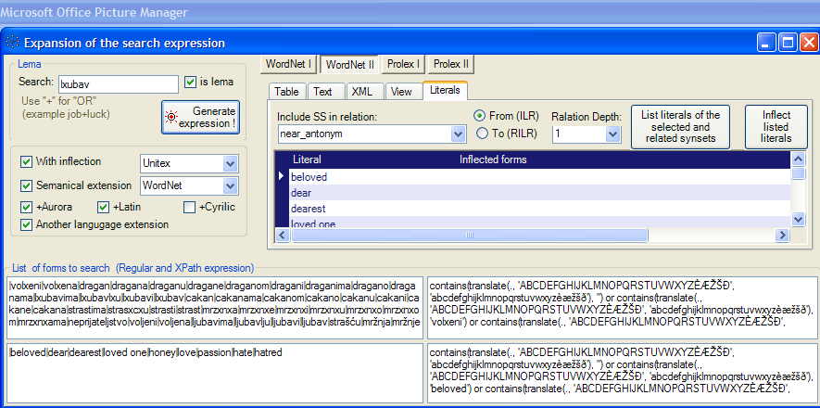
LeXimir – searching bitexts by expending queries with Wordnets and morphological e-dictionaries
user’s keyword
ljubav
semantic expansion
- Wordnet
morphological expansion
- Serbian e-dict
bilingual expansion
- Wordnet

Slide 24
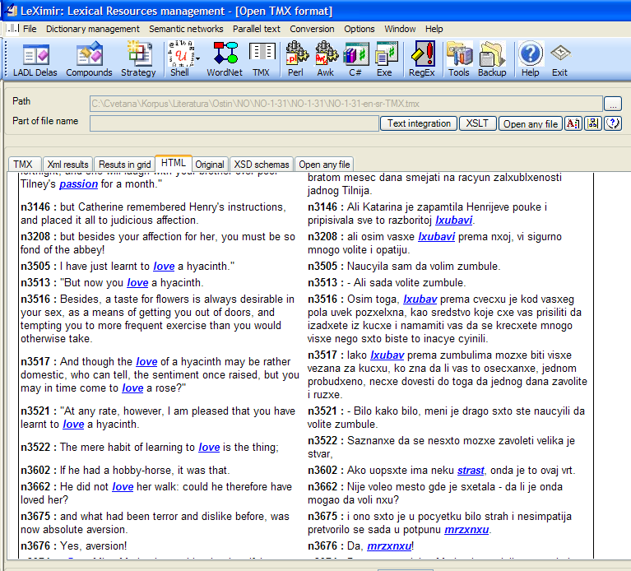
LeXimir – results
basic - ljubav
synonym - strast
antonym –
mržnja

Slide 25
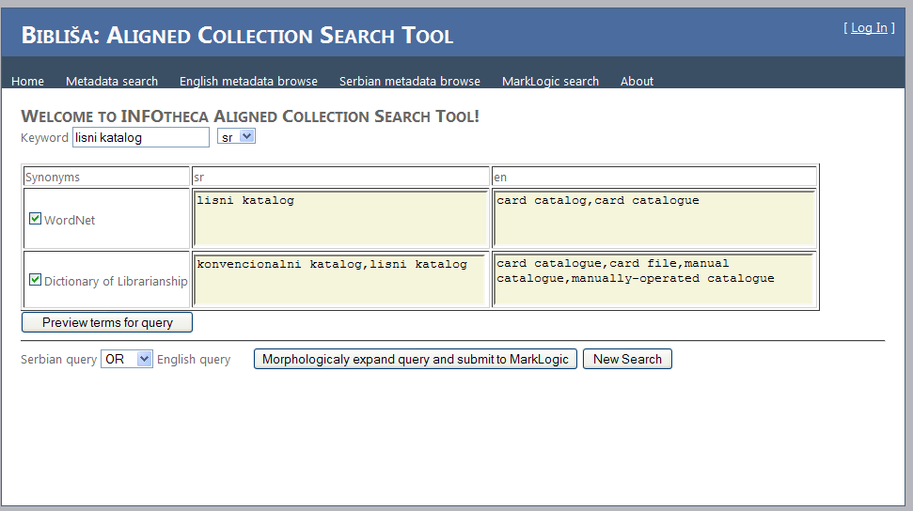
Bibliša – expanding a search by: morphological e-dict, wordnet, terminological database
user’s query –
lisni katalog
bilingual expansion –
Wordnet
bilingual expansion –
LIS terminology DB
morphological
expansion
- Serbian e-dict

Slide 26
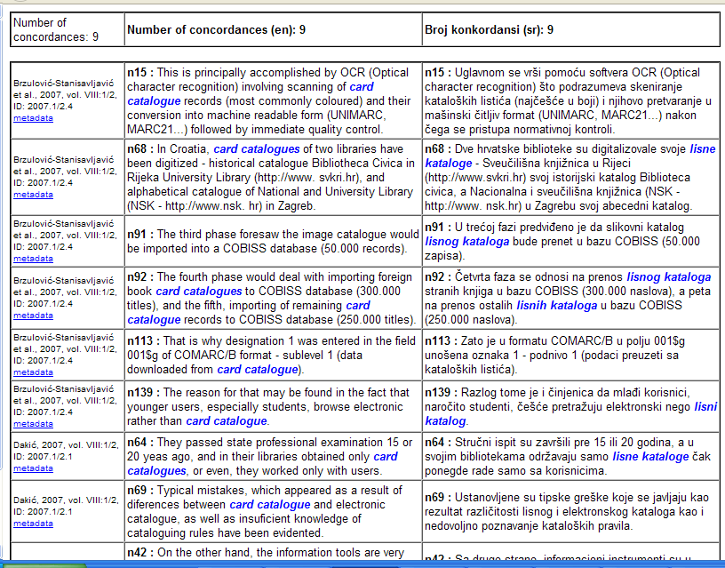
Bibliša – results of searching an aligned collection of INFOtheca papers
morphological
expansion of
MWUs
http://hlt.rgf.bg.ac.rs/Biblisha

Slide 27
Thanks!

