Slide 1
Dictionary graphs
Duško Vitas
University of Belgrade,
Faculty of Mathematics

Slide 2
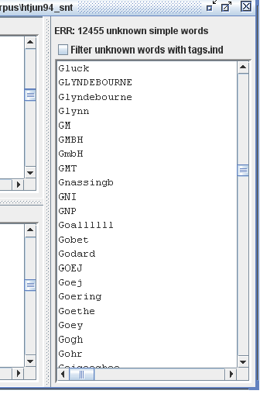
Dictionaries of a text
The words in the text not found in the dictionaries that are usually called „unknown words“ (it is better to call them „unrecognized words“).
They are recoreded in a file err in a text folder.
2

Slide 3
What are unrecognized words
Proper names as Gluck, Goethe, Gohr, Glindebourne...
Acronyms as GMBH, GmbH, GNP...
Occasional elements as Goallllll,... (https://www.facebook.com/media/set/?set=a.135749786435603.23668.134710763206172)
or in Bulgarian, as наздравеее! (https://twitter.com/benkovski/status/408941544406663168)
Typographic errors
Deriavtional elemenst, like in Seribian aviotransport, osmostruki, devedestodnevni... but also 28-godišnji, 1.5%-tni...
Words from other languages as in Serbian texts offshore, tabacum,...
...

Slide 4
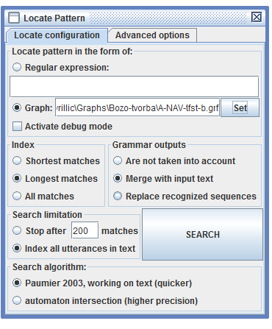
Dictionary graphs
Dictionary graphs – they are transducers that if applied for searching a pattern in a text (option Locate pattern) in a mode Merge, produce sequences that are valid DELAF entries.

Slide 5
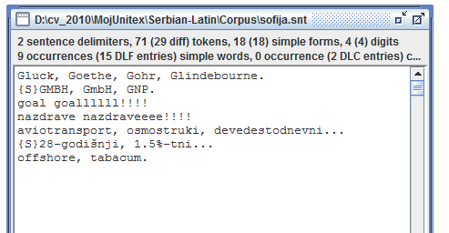
Problem
Is it possible to approximate a unrecognized word on the basis of its structure (that is, elements already in e-dictionaries)?
Text contains words that are listed in the err file.

Slide 6
The first approximation
<MAJ> recognize any sequence of letters in upper case, a graphs name is Acr+.grf (lower priority)

Slide 7
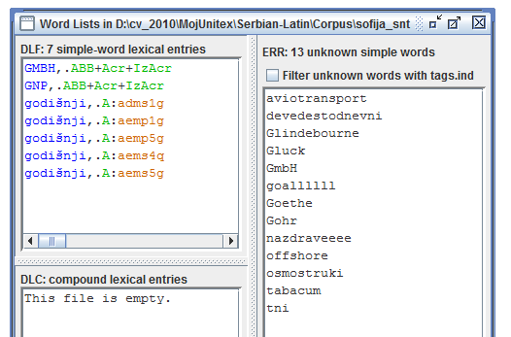
If a compiled graph Acr+.fst2 is put in a directory DELA (that contains dictionaries), than the forms recognized by a graph will be listed among recognized words!

Slide 8
Proper Names
They can use the results of previously applied dictionaries.
As a matter of fact, a dictionary graph can be given a lower priority and it is then applied only to simple word forms that standard dictionaries didn’t cover.
This graph tags as nouns all simple word forms with an upper-case initial that are not in the dictionary of simple forms. This words receive semantic tags +NProp (a proper name) and +Unknown (of unknown kind).
Green brackets define a context (later).
<PRE> any simple word with capitalized first letter (NProp+.grf)

Slide 9
Other advantages of dictionary graphs
9

Slide 10
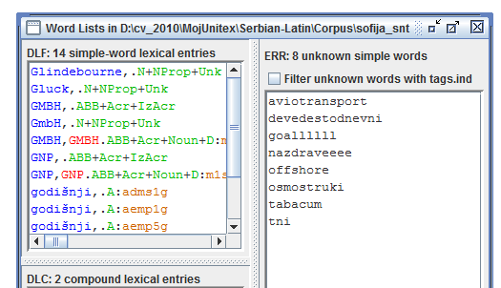
Priority
A form GmbH corresponds to a pattern for proper names (NProp), and not to a pattern for acronyms (Acr), so it will be marked as a proper name.
For Serbian, ther is a separate dictionary of acronyms, so GMBH is tagged twice:
As a acronym, according to the graph Acr+.grf
As a line from the DELAF type dictionary

Slide 11
Forcing case
11
One of advantages of these transducers is that they can use quotation marks to force case.
One example of this is recognition of chemical elements. For instance, “Na” will recognize only Na while pattern Na recognizes both Na and NA. Such possibility does not exist in normal dictionaries.

Slide 12
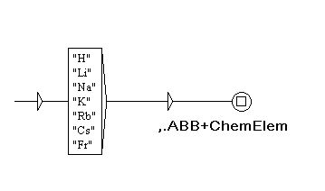
An example of a dictionary graph that recognizes some chemical elements
This graph recognizes symbols of chemical elements sodium, potassium, lithium, etc. and assign them as a PoS ABB (abbreviation) with addition of a semantic marker +ChemElem. It has the same effect (except for forcing the upper-case initial) as a line in a DELAF dictionary:
Na,.ABB+ChemElem

Slide 13
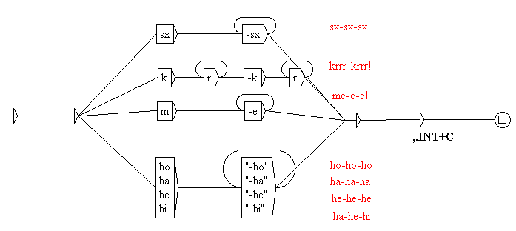
One dictionary graph – compound interjections
Dictionary graphs can recognize as one unit something that consists of several components that can combine in more or less free fashion.
Why can’t we use usual dictionary lemmas for this?
Because we don’t know how many repetitions there can be.
This graph covers only repetitions of separated components (by a space or a hyphen) and not cases like Aaaaah.
This graph recognizes
compound interjections

Slide 14
Appication of dictionary graphs
They can be given a lower priority if a plus sign + is added to their name. It means that they are applied only to unknown words (content of err after applying regular dictionaries).
Compile them and obtained .fst2 include in a list of dictionaries that are applied to a text.
Recognized sequences with corresponding output will become a content of the DLC of analyzed text.
For instance, a line in DLC for one of recognized interjections is:
Sx-sx-sx-sx,.INT+C

Slide 15
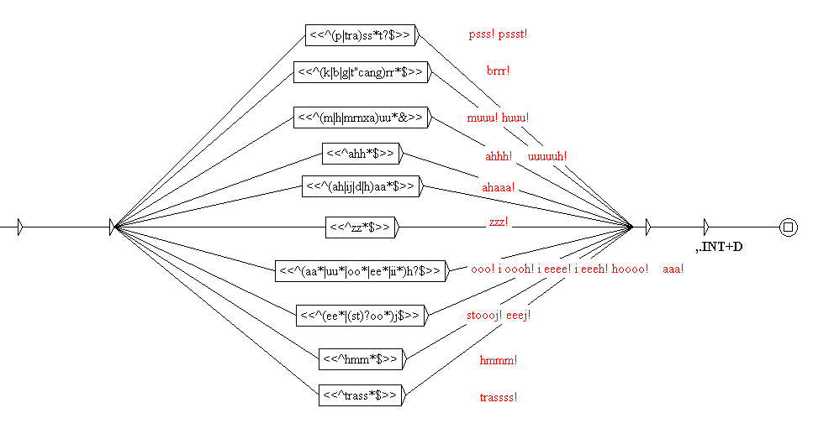
Dictionary graphs that use morphological filters
Dictionary graphs can use morphological filters – actually they can use anything that syntactic graphs can use.
This graph recognizes interjections in which some letters repeat several times.
What is recognized in text with a lexical mask <INT+D>?
What is recognized in text with a lexical mask <INT+C>?

Slide 16
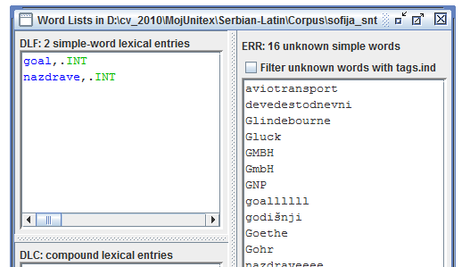
The file err contains: goal, goallll and nazdraveee...
If we produce a DELAF type dictionary INT.dic that contains lemmas goal and nazdrave as interjections.
The application of this dictionary to the text recognizes these two interjections, but not nazdraveeee and goallll.

Slide 17
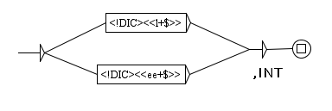
Morphological filter

Slide 18
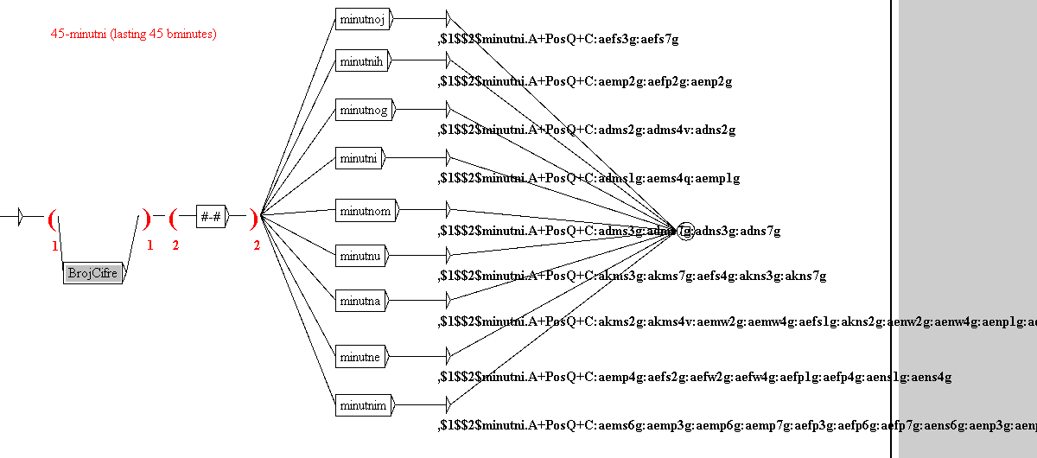
More on dictionary graphs
Recognition of various compounds in which some components are numerals written with digits.
Lemmas and grammatical categories are assigned to recognized compounds.
That way correct DELAF entries are obtained.

Slide 20
What does this graph do?
It recognizes multi-word units that begin with a numeral written with digits (a sub-graph BrojCifre) followed by a hyphen (no spaces around a hyphen) followed by some form of the adjective minutni.
The recognized numeral becomes a value of a variable $1, a separator becomes a value of a variable $2.
This variables are used in the output of a transducer to form a canonic form (lemma) - $1$$2$minutni
PoS assigned to a canonic form is – A – (an adjective) and the additional markers are: +PosQ+C
Every form of the adjective minutni is followed by its set of codes of grammatical categories.

Slide 21
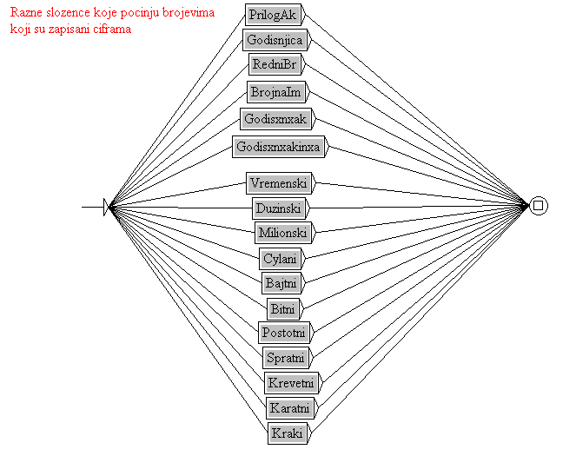
What does such dictionary graphs recognize in a text (used as syntactic graphs)?
A dictionary graph Minutni recognizes in a collection 5izvora Minutni
Subordinate graph Razno recognizes various multiword units formed in a similar way: nouns, adjectives and adverbs.
A dictionary graph Razno recognizes in a collection 5izvora various MWU with digits

Slide 22
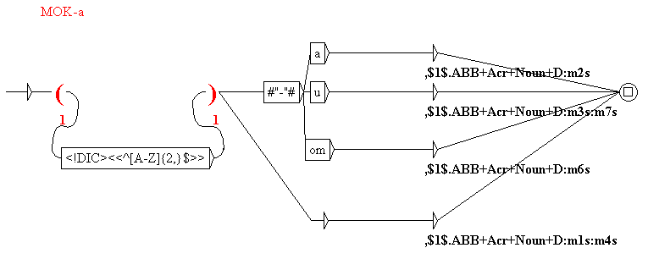
Dictionary graphs – the second example
Recognizes as nouns (the masculine gender, inanimate) all acronyms followed by the case ending.
Acronyms are recognized by a morphological filter <!DIC><<^[A-Z]{2,}$>>
A recognized acronym becomes a value of a variable $1 that is in the transducer’s output used as a canonic form.
The recognized acronym gets as a PoS a tag ABB and additional markers - +Acr+Noun+D

Slide 23
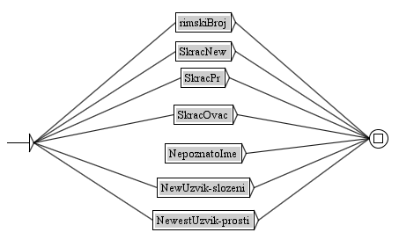
What does such dictionary graphs recognize in a text (used as syntactic graphs)?
In a text 5izvora-izvod retrieves acronyms with a dictionary graph Acr+.
Attention- in order to obtain this output a graph has to be applied to a text for location that has not been processed with it (because of the mask) <!DIC>.
A subordinate graph NaKraju recognizes adjectives, noun, roman numerals and various interjection. In the same text it recognizes at the end..

Slide 24
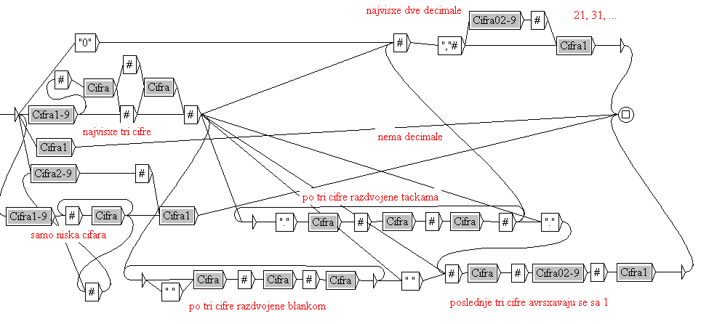
Dictionary graphs – the third example
Dictionary graphs recognize numerals written with digits, words and their combination.
They take care about the agreement various numerals impose.

Slide 25
A sub-graph of a dictionary graph for numerals– BrojSamoSifreJ.grf
Recognizes all numerals written with digits that end with a digit 1 (but not 11).
Includes a recognition of decimal numbers with a decimal comma.
Includes a recognition of great numbers with digits grouped three by three (separated by a point or a space).

Slide 26
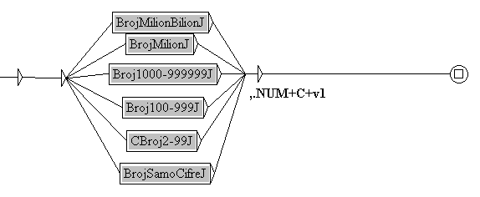
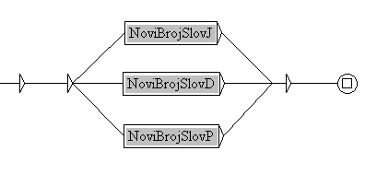
What else contains a dictionary graph for recognition of numerals?
A subordinate graph NoviBrojSlovJ.grf recognizes all numerals that impose agreement as a numeral 1 and which can be written with digits, words or their combination.
A subordinate graph NoviBrojSlovima recognizes all numerals, written in any possible way, with various types of agreement.

Slide 27
What is recognizes by the graph NoviBrojSlovima?
In a short text 5izvora-izvod recognizes and tags following numerals.
Sub-graphs cannot be used on their own, there is a lot of false – strange recognitions. They are useful only when used together.
There are other errors, what about them? Other graphs – e.g. for recognition of dates – will remove them.

Slide 28
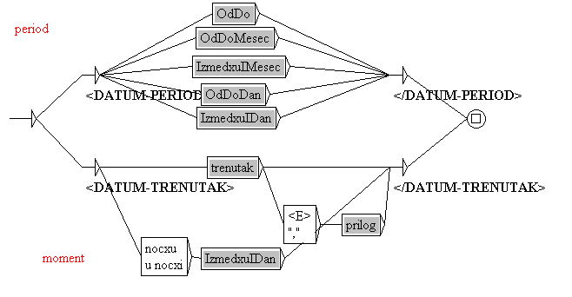
A local grammar (a syntactic graph) for recognition of dates
It is not a dictionary graph.
It is a transducer that produces XML tags.
It could become a dictionary graph if we would delimit our recognitions only to, for instance, adverbial constructions.

Slide 29
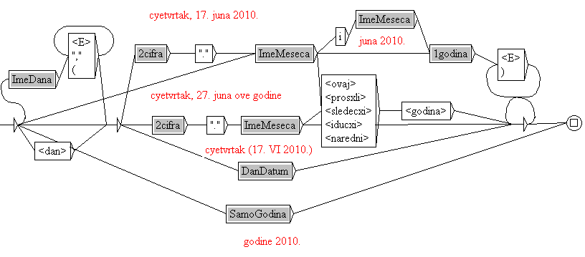
One sub-graph of a syntactic graph Datum
It recognizes a date – precisely or vaguely expressed

Slide 30
What does this graph recognize?
In a text 5izvora recognizes and tags following dates.
A tagged text looks like this: XML text

Slide 31
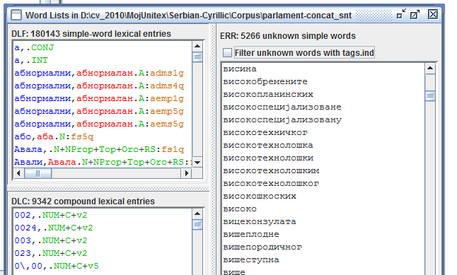
Finally, compounds
err contains also compounds that can be approximated by the content of DELAF dictionaries when using morphological dictionary graphs (dictionary graphs used in morphological mode)
One such pattern
A(<E>+-)(N+V+A)
Can be used for examples as
visokotehnički, visokotehnološki, prvospomenuti, devedesetodnevni,...

Slide 32
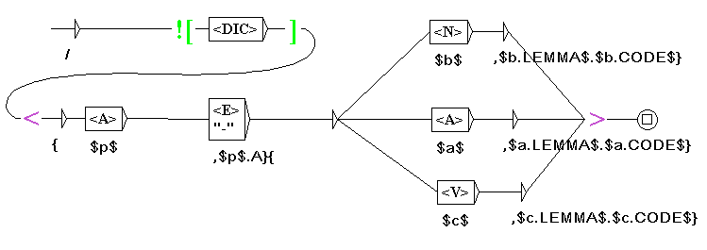
One morphological dictionary graph
Graph has at the begining / as a marker that it is a morphological graph
Words that are not in applied dictionaries: ![<DIC>]
Switch to morphological mode
$p$, $a$, $b$, $c$ - variables that keep the recognized part of input
Value of the variable p, followed by a lemma and grammatical code
of variables a, b or c is produced as an output.

Slide 33
tags.ind
$p$ $a$, $a.LEMMA$ $a.CODE$
{високо,A}{технолошки,технолошки.A+PosQ:aems4q}
{високо,A}{технолошки,технолошки.A+PosQ:aems5g}
{високо,A}{техничког,технички.A+PosQ:adms2g}
{високо,A}{техничког,технички.A+PosQ:adms4v}
{високо,A}{техничког,технички.A+PosQ:adns2g}
{високо,A}{технолошког,технолошки.A+PosQ:adms2g}

Slide 34
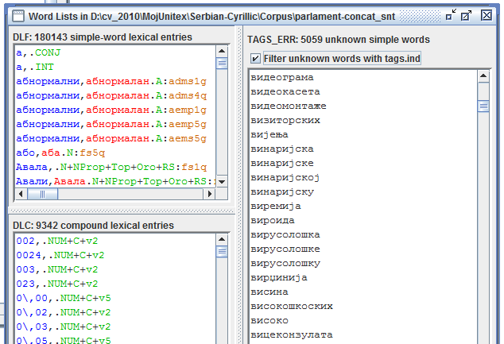
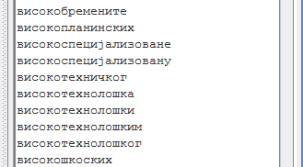
Elimination of unrecognized words from err

Slide 35
Thanks!

